Slide 1
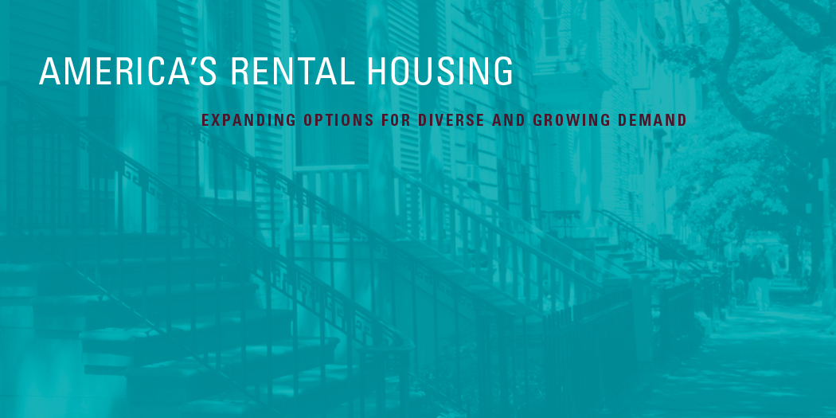
Supported by the John D. and Catherine T. MacArthur Foundation

Slide 2
America’s Rental Housing
Expanding Options for Diverse and Growing Demand

Slide 3
Rental Housing Demand

Slide 4
Renter Household Growth Has Surged with the Drop in Homeownership

Slide 5
Gen-Xers and Baby Boomers Have Driven Most of the Recent Growth in Renter Households

Slide 6
The Decade-Long Increase in Renter Households Has Been Broad-Based

Slide 7
Rental Housing Supply

Slide 8
The Rental Stock Provides Diverse Housing Options

Slide 9
Rents for New Multifamily Units Are Out of Reach for Most Renter Households
Note: Income category cutoffs align with rent category cutoffs at the 30% of income affordability standard.
Sources: US Census Bureau, 2015 Survey of Market Absorption and 2015 Current Population Survey.

Slide 10
While Filtering Helps to Replenish the Supply, Affordable Units Are Often Lost to Upgrading

Slide 11
Lowest-Cost Rentals are Most Likely to Have Major Quality Issues

Slide 12
Rental Market Conditions

Slide 13
Rent Increases Continue to Outpace Inflation

Slide 14
Vacancy Rates Have Fallen Sharply in Markets Across the Country

Slide 15
Multifamily Starts Are at Their Highest Level Since the 1980s, and Completions Are Set to Increase

Slide 16
Prices for Apartment Properties Have Rebounded Well Beyond Their Previous Peak

Slide 17
Private Lenders Have Ramped Up Multifamily Lending, Reducing the Government’s Footprint in the Market
Multifamily Loan Originations (Billions of Dollars)

Slide 18
Rental Housing Affordability

Slide 19
The Share of Renter Households Facing Cost Burdens Remains High as Income Growth Lags

Slide 20
Cost Burdens Are a Fact of Life for Lowest-Income Renters, But Are Becoming More Common Among Middle-Income Households as Well
Notes: Household incomes are adjusted to 2014 dollars using the CPI-U for All Items. Moderately (severely) cost-burdened households pay more than 30% and up to 50% (more than 50%) of income for housing. Households with zero or negative income are assumed to have severe burdens, while households paying no cash rent are assumed to be without burdens.
Source: JCHS tabulations of US Census Bureau, American Community Surveys.

Slide 21
While Most Lowest-Income Households Have Cost Burdens, the Cost-Burdened Share of Moderate-Income Renters Varies Widely Across Markets

Slide 22
Lowest Income Renters Far Outnumber the Affordable, Adequate, and Available Rental Supply
Average Number of Units per 100 Extremely Low-Income Renter Households
Notes: Affordable is deﬁned as costing no more than 30% of income for households with extremely low incomes (up to 30% of area median). Adequate units have complete bathrooms, running water, and electricity, and no indicators of major disrepair. Available units are not occupied by higher income renter households.
Source: JCHS tabulations of Urban Institute, Mapping America’s Rental Housing Crisis 2011–13.

Slide 23
Paying an Outsized Share of Income for Housing Crowds Out Spending on Other Vital Needs
Notes: Severely cost-burdened households pay more than 50% of income for housing. Households with zero or negative income are assumed to be severely burdened, while households paying no cash rent are assumed to be without burdens. Quartiles are equal fourths of all households ranked by total spending. Retirement expenditures are for renters under age 65 only.
Source: JCHS tabulations of US Bureau of Labor Statistics, 2014 Consumer Expenditure Survey.

Slide 24
Policy Challenges

Slide 25
Growth in the Number of Lowest-Income Renters Far Outstrips Increases in Assisted Households
Household Income

Slide 26
Over Time, Tax Credits Have Joined Vouchers as the Largest Forms of Rental Assistance
Notes: Units can be assisted through more than one program. The count of LIHTC units is cumulative and the 2014 estimate is the annual average number of units placed in service in 2009–13. Project-based rental assistance refers to units subsidized through project-based Section 8, Rent Supplement Program, Rental Assistance Payments, and Project Rental Assistance Contracts for Section 202 and Section 811 programs.
Source: US Department of Housing and Urban Development, FY1999–2014 Annual Performance Reports and LIHTC Database.

Slide 27
More than Half of Affordable Units with Expiring Subsidies Charge Below-Market Rents
Notes: FMR (fair market rent) includes rent plus tenant-paid utility costs. Project-based rental assistance refers to units subsidized through project-based Section 8, Rent Supplement Program, Rental Assistance Payments, and Project Rental Assistance Contracts for Section 202 and Section 811 programs.
Source: JCHS tabulations of National Housing Preservation Database.

Slide 28
Compared with Public Housing, LIHTC and Voucher Units Are Less Concentrated in High-Poverty, High-Minority Areas
Poverty Rate in Census Tract (Percent)
Notes: Poverty rate refers to share of families in census tract that are living below the poverty level
Source: JCHS tabulations of US Census Bureau, 2009-2013 Five-Year American Community Survey; US Department of Housing and Urban Development, 2013 Picture of Subsidized Households and LIHTC database.

Slide 29
Rental Assistance Predominantly Serves Adults Who Are Elderly, Have Disabilities, or Care for Children
Share of Assisted Households
Notes: Elderly adults are aged 62 and over, the cutoff for age-restricted units. Adults with disabilities are under age 62. Household counts include those assisted by Housing Choice Vouchers, Public Housing, Project-Based Section 8, Section 202, Section 811, Rent Supplement, Rental Assistance Program, McKinney-Vento Permanent Supportive Housing, Housing for Persons with AIDS, and USDA Section 521.
Source: CBPP, Federal Rental Assistance Factsheet.

Slide 30
Supported by the John D. and Catherine T. MacArthur Foundation

