Slide 1
Joint Center Fellowships and Grants
Student Information Session, February 9, 2024

Slide 2
What is the Joint Center for Housing Studies?
A joint entity affiliated with both gsd and hks
Our mission is to improve equitable access to decent, affordable homes in thriving communities.
We do this by
Conducting rigorous research
Bringing together diverse stakeholders
Supporting the next generation of housing leaders
https://www.jchs.harvard.edu/about

Slide 3
What Summer Opportunities Does the Center Offer?
Gramlich Fellowship in Community and Economic Development
Summer Community Service Fellowships (GSD)
Summer Fellowships in Housing and Community Development (HKS)
Ivory Fellowship in Housing Affordability and Sustainability
Summer Research Fellowship on Rental Housing Ownership
Student Research Support Program
Meyer Doctoral Dissertation Fellowship
https://www.jchs.harvard.edu/students

Slide 4
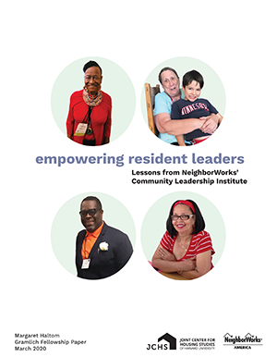
Gramlich Fellowships in Community & Economic Development
OPEN TO ALL HARVARD GRADUATE STUDENTS
Research challenges facing organizations in the NeighborWorks America network, such as:
Developing collaborative partnerships to advance health equity
Using ADUs to provide affordable housing
CBOs that work in historically segregated neighborhoods
Sustaining “middle neighborhoods” in Mountain West cities
Present findings to practitioners, policy experts and others publish work as a Joint Center working paper
Full time for 10 weeks in the summer weeks plus some work during academic year
$9,000 stipend
Applications are due by Tuesday, February 20
https://www.jchs.harvard.edu/students/edward-m-gramlich-fellowship-community-and-economic-development-harvard-graduate-students

Slide 5
GSD Summer Community Service Fellowship HKS Summer Fellowship in Housing & Community Development
Students arrange for 10-week, full-time fellowships with public or non-profit entities, such as:
Preservation of Affordable Housing, Inc. (POAH)
Boston’s Housing Innovation Lab
NYC Department of Housing Preservation and Development
Strategic Actions for a Just Economy (LA)
Full-time for 10 weeks in the summer
$8,000 stipend
GSD applications are due by Monday, April 1
HKS applications due by Friday, March 22
https://www.jchs.harvard.edu/students/summer-community-service-fellowship-gsd-students https://www.jchs.harvard.edu/students/summer-fellowships-housing-community-development-hks-students

Slide 6
Ivory Fellowship in Housing Affordability and Sustainability
Open to Any Harvard Graduate OR UNDERGRADUATE Student
Focus on issues related affordable and sustainable housing
Placements can be at for-profit companies, non-profit organizations, or public-sector entities in the United States
Preference given to students who work with organizations that have been finalists for the Ivory Prize for Housing Affordability
Full-time for 10 weeks
8,000 stipend (grad students), $6,500 (undergraduates)
Applications are due by Wednesday, March 20
https://www.jchs.harvard.edu/students/ivory-fellowship-housing-affordability-and-sustainability

Slide 7
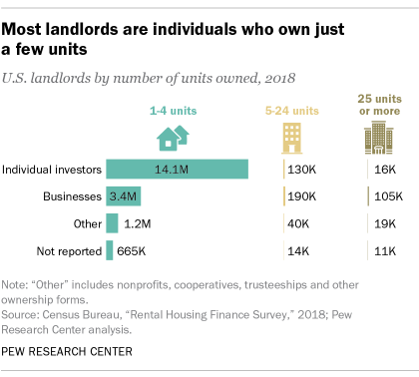
Summer Research Fellowship on Rental Housing Ownership
Open to Any Harvard Graduate OR UNDERGRADUATE Student
Carry out quantitative research on the ownership of rental housing.
Clean, code, merge, and analyze county records,
Work with county employees as needed to understand the data
Analyze and summarize data with guidance from the JCHS research team.
Summarize findings.
Full time in summer; may be extended
Hourly wage commensurate w/experience
Open until filled
https://www.jchs.harvard.edu/students/student-research-fellowship-rental-housing-ownership

Slide 8
Student Research Support Program
Open to Any Harvard Graduate Student
x
Provides up to $7,000 grants to Harvard faculty members to hire graduate students who either
Working on the faculty member’s project
Do independent work supervised by the faculty member
Recent grants funded work on
Measuring Neighborhood Disinvestment in Boston
Designs for Denser Housing in New Zealand
The Value of Public Meetings for Planners
Planning for Rebuilt Housing in Ukraine
Applications must be submitted by a faculty member
Applications are due by Monday, April 1
https://www.jchs.harvard.edu/students/student-research-support-program-harvard-faculty-and-graduate-students

Slide 9
Meyer Dissertation Fellowships
Open to doctoral students from throughout Harvard
Provides support for doctoral candidates at the thesis-writing stage
Recipients receive an $8,000 stipend.
Recipients present their work at our Housing Research Seminar
Recipients also publish a Center working paper and blog
Recipients can access Center resources, networks, and expertise
Current recipients are writing about
Art Centered Development in Neighborhoods of Color
Housing Liquidity and Macroeconomic Stabilization
Anti-Growth Policies and the Rise of Modern Liberalism
Applications are due by Monday, April 8
https://www.jchs.harvard.edu/students/john-r-meyer-dissertation-fellowship-harvard-doctoral-students

Slide 10
Questions?
david_luberoff@harvard.edu

