Slide 1
The State of the Nation’s Housing 2022
Harvard Joint Center for Housing Studies
Friday Research Seminar
September 16, 2022

Slide 2
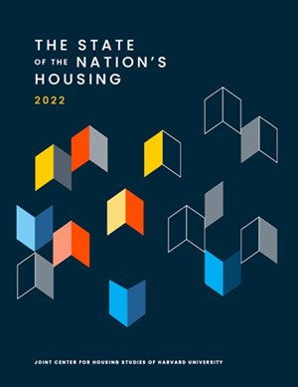
State of the Nation’s Housing 2022: Major Themes in the Report
The Soaring Costs of Housing
Persistent Affordability Challenges
Construction Levels Hitting Records
Household Growth on the Rise
High Hurdle for First-Time Buyers
Growing Housing Inequities
The Outlook for Housing
Notes:
There’s truly no shortages of stories to recount in this years report.
The soaring costs of housing and the records set both in prices and rents.
The rise in demand and surprisingly strong levels of household growth given we are in a pandemic.
The record high levels of construction trying to meet that demand despite supply chain issues
Then we get to 2022 and jump in interest rates and the impact that’s having on the ability to own a home – and who can afford to buy a home
If the door is closing on affordable mortgages, who is that shutting out and what inequalities is that locking in given the significant homeownership rate gaps by race.
Then we look at the persistent affordability challenges that returning just as pandemic aid is spend, moratoria end, and inflation hits a 40 year high.
Then we get to the outlook for what this all means going forward both in the short term, and in the long term.
Record-Setting Year for Housing Markets
Record High Price Appreciation and Rent Growth
Record Low Inventories for Sale and Rental Vacancies
Household Growth Strong Despite the Pandemic
Millennials Forming Households, Lifting Household Growth
Baby boom driving up number of older adult households
Construction Levels Responding, but Dragged by Supply Chain Issues
Record Number of Units Under Construction
Homeownership Rates Up
Rising Interest Rates Shutting Door on Affordable Mortgages
Price Increases Building Huge Equity Gains for Owners – Renters Miss Out
End of Federal Supports at a Time When Households Still Struggling
Cost Burden Rates and Share Missing rental payments still sizeable, even increasing in Early 2022
Inflation Hitting Low Income Households Already Strapped for Cash
Going Forward – Eyes on the Economy and the Fed, Longer Term Slowing Likely
Momentum at State and Local Level to Address Zoning Barriers
More Momentum Needed for Adapting Stock for Climate Change, Older Adults Accessibility Needs.

Slide 3
High Rates of Inflation Have Persisted
Percent Change Y/Y
Source: Freddie Mac Primary Mortgage Market Survey

Slide 4
Interest Rates—Particularly for Mortgages—Have Continued to Rise
Percent
Source: Freddie Mac Primary Mortgage Market Survey

Slide 5
Unemployment Has Remained Low…And Wage Growth Has Been Strong
Percent
Source: US BLS Consumer Price Index and Employment Cost Index

Slide 6
The Soaring Costs of Housing
Notes:
I’ll begin with the soaring costs of housing.

Slide 7
Home Price Appreciation Set New Records in the Past Year
Annual Change (Percent)
Note: Real home prices are adjusted for inflation using the CPI-U for All Items less shelter.
Source: JCHS tabulations of S&P CoreLogic Case-Shiller US National Home Price Index.

Slide 8
Rents for Both Apartments and Single-Family Homes Have Surged
Notes: Single-family rent increases in 2022:1 are for January and February alone. CoStar same-store rents are for professionally managed market-rate apartments in buildings with five or more units.
Source: JCHS tabulations of CoStar data; CoreLogic Single-Family Rent Index.

Slide 9
Rents in Large Metro Markets Were Growing Much Faster in Mid-2022 Than They Were a Year Earlier
Note: Asking rents are for professionally managed apartments in buildings with five or more units in the 150 markets that RealPage tracks.
Source: JCHS tabulations of RealPage data.

Slide 10
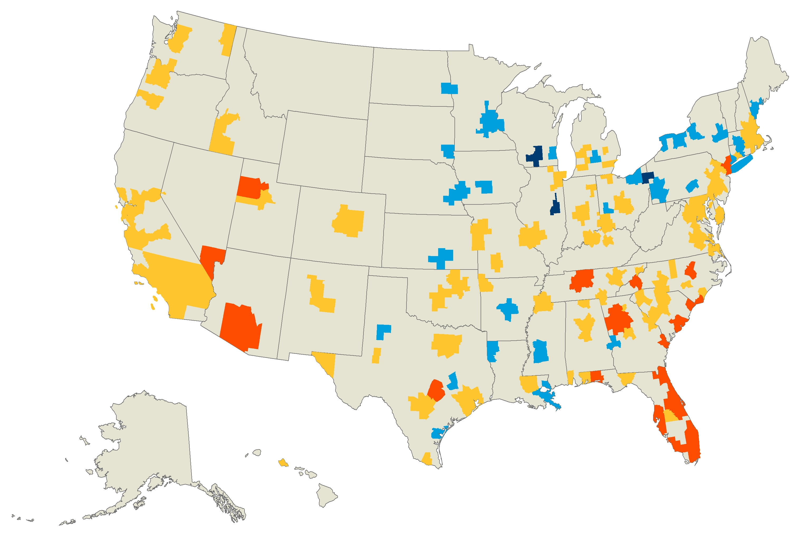
Rents in Most Major Markets Were Up by Double Digits in Early 2022
Change in Asking Rents
2021:1–2022:1 (Percent)
Under 5.0 (Down to 1.0)
5.0–9.9
10.0–19.9
20.0 and Over (Up to 42.0)
Note: Asking rents are for professionally managed apartments in buildings with five or more units in the 150 markets that RealPage tracks.
Source: JCHS tabulations of RealPage data.

Slide 11
Vacancy Rates Have Fallen Back Near Historic Lows Even in Prime Urban Areas
Submarket
Notes: Urban/suburban areas are based on density in the 54 largest markets that CoStar tracks. Prime submarkets have the highest rents..
Source: JCHS tabulations of CoStar data.

Slide 12
The Supply of Homes on the Market Reached New Lows in 2022 but Are Beginning to Climb
Existing Homes for Sale (Millions)
Months of Supply
Note: Months of supply measure how long it would take homes on the market to sell at the current rate, where six months are typically considered a balanced market.
Source: JCHS tabulations of NAR, Existing Home Sales.

Slide 13
Investors Are Buying Up a Record Share of Single-Family Homes
Note: Data are 3-month trailing averages.
Source: JCHS tabulations of CoreLogic data.

Slide 14
Persistent Affordability Challenges

Slide 15
Affordability Challenges Worsened in the First Year of the Pandemic for Both Renters and Homeowners
Share of Households with Cost Burdens (Percent)
Notes: Cost-burdened households spend more than 30 percent of incomes on housing costs. Data for 2019 use specially provided experimental weights from the US Census Bureau to allow for comparisons between 2019 and 2020.
Source: JCHS tabulations of US Census Bureau, American Community Survey 1-Year Estimates using experimental weights.

Slide 16
Middle-Income Renters’ Cost Burdens Soared in 2020
Notes: Moderately (severely) cost-burdened households pay more than 30% up to 50% (more than 50%) of household income for housing. Households with zero or negative income are assumed to be severely burdened, while households paying no cash rent are assumed to be unburdened. Household incomes are inflated to 2020 dollars using CPI-U All Items.
Source: JCHS tabulations of US Census Bureau, 2019 & 2020 Experimental American Community Survey 1-Year Estimates.
Notes:
The figure shows the percentage point increase in cost burden shares by income and the cost burden rates by income for 2019 and 2020. Households making between $30,000 and $45,000 had by far the largest increase in cost burden rates at about 9 percentage points. Despite this increase, households making less than $30,000 continue to have the highest cost burden rate at 80 percent.

Slide 17
Many Lower-Income Households and Households of Color Still Struggled to Pay Rent in Early 2022
Notes: Households behind on rent reported that they were not caught up at the time of the survey. Black, Asian, and white householders are non-Hispanic. Hispanic householders may be of any race(s).
Source: JCHS tabulations of US Census Bureau, Household Pulse Surveys, December 2021–April 2022.

Slide 18
Eviction Filings Are Nearing Pre-Pandemic Averages
2020
2021
Note: Data include eviction filings in 6 states and 31 cities.
Source: JCHS tabulations of Eviction Lab, Eviction Tracking System through June 30, 2022.

Slide 19
Rising Inflation Puts Pressure on Household Budgets, Especially for Lower-Income Households
Annual Change in Prices in August (Percent)
Source: JCHS tabulations of US Bureau of Labor Statistics, Consumer Price Indexes.

Slide 20
Construction Levels Hit Historic Highs

Slide 21
Costs of Building Materials Have Soared Since the Start of the Pandemic
Note: Inputs to new residential construction are not a composite of the other components, and exclude capital, labor, and imports.
Source: JCHS tabulations of US Bureau of Labor Statistics, Producer Price Indexes.

Slide 22
New Construction Picked Up Sharply Last Year…
Note: Housing starts for 2022 are the average of the seasonally adjusted annual rate for January–April.
Source: JCHS tabulations of US Census Bureau, New Residential Construction data.

Slide 23
… But Single-Family Construction Has Dipped in Early 2022 as Interest Rates Climb
Note: Single-family and multifamily historical averages are of seasonally adjusted monthly data from January 1990 to July 2022.
Source: JCHS tabulations of US Census Bureau, New Residential Construction data.

Slide 24
Record Numbers of Homes Remain Under Construction
Source: JCHS tabulations of US Census Bureau, New Residential Construction data.

Slide 25
Housing Demand on the Rise

Slide 26
Household Growth Has Remained Strong Despite the Pandemic
Source: JCHS tabulations of US Census Bureau, Housing Vacancy Surveys.

Slide 27
Household Growth among Adults in Their Mid-30s to Mid-40s Has Picked Up Pace
Age of Household Head
Source: JCHS tabulations of US Census Bureau, Housing Vacancy Surveys.

Slide 28
Overall, Housing Construction Has Struggled to Kept Pace with Household Growth for a Decade
Units (Millions)
Notes: Household growth data are three-year trailing averages. Placements refers to newly built mobile homes placed for residential use.
Source: JCHS tabulations of US Census Bureau Housing Vacancy Survey, New Residential Construction data.
Notes:
Single family construction still below 1 million units for the 11th year in a row. Prior to 2008 only 2 years where sf construction dipped below 1 million.
7 years into the recovery, total completions & placements of 1.23 million well below
Historical annual average since 1980-2018 = 1.5 million

Slide 29
Growth in Rental Demand Has Slowed, but Still Outpaced Supply in Q2
Note: Data are four-quarter rolling averages for professionally managed apartment buildings with five or more units.
Source: JCHS tabulations of RealPage data.
Notes:
Soaring prices have kept many would-be homeowners in rental housing, contributing to the already strong growth in renter households.
Perhaps nowhere was the rebound in demand (and the imbalance between supply and demand) more apparent than in the apartment rental markets, as shown by this chart.
RealPage reports that net new leases for professionally managed apartment properties were up by 713,000 units in the first quarter of 2022 compared with a year earlier, the largest annual increase in net occupancy in records going back to 2000.
as RealPage data show, despite completions running at a robust 349,000 unit annual rate in the first quarter of 2022, the number of occupied apartments was rising at more than twice that pace
over 700,000 occupied rental apartments in in a single year.
It will take a significant increase in housing production for the rental supply to match such strong demand.

Slide 30
High Hurdles for Homebuyers

Slide 31
Homeownership Has Been Climbing Through the Pandemic
Homeowners (Millions)
Homeownership Rate (Percent)
Source: JCHS tabulations of US Census Bureau, Housing Vacancy Surveys.

Slide 32
Recent Interest Rate Hikes Have Further Eroded Affordability
 | April 2021 | April 2022 | July 2022
Interest Rate (Percent) | 3.06 | 4.98 | 5.41
Median Home Price (Dollars) | 340,700 | 391,200 | 403,800
Downpayment & Closing Costs | 22,100 | 25,400 | 26,250
Monthly Mortgage Payment | 1,400 | 2,020 | 2,190
Total Monthly Owner Costs | 2,060 | 2,780 | 2,970
Annual Income Needed | $79,600 | $107,600 | $115,000
Note: Estimates assume 3.5% downpayment on a 30-year fixed rate loan with zero points, 0.85% mortgage insurance, 0.35% property taxes, 1.15% property taxes, 3% closing costs, and a maximum 31% debt to income ratio.
Source: JCHS tabulations of Freddie Mac, Primary Mortgage Market Surveys; NAR, Existing Home Sales.
Notes:
However, in 2022, the sharp rise in interest rates in early 2022 has had an enormous impact on the costs of homeownership, and priced many out of the market.
Indeed, the impact on monthly mortgage payments of the 2.0 percentage point hike in interest rates between late December 2021 and mid-April 2022 is equivalent to that of a 27 percent jump in home prices.
But with prices continuing to rise along with interest rates, the savings and income needed to qualify for a home has skyrocketed over the past year.
Under standard terms, the monthly mortgage payment on the median-priced home rose from $1,400 to a hefty $2,020.
The minimum income needed to afford these payments from $79,600 in April 2021 to $107,600 in April 2022—effectively pricing out some 4 million renter households with incomes in this range.
Markets are cooling
Indeed, the pace of home sales fell 14% between January and April, from 6.5 million units in January to 5.6 million units in April
Mortgage Bankers Association reported average home purchase mortgage applications is down 16 percent year-over-year in mid-May
In addition, the Michigan Surveys of Consumers reported that the share of households that considered it a good time to buy a home stood at just 35 percent in the first quarter of 2022, the lowest reading since the early 1980s.
Given the additional bump in interest rates in May, home sales are likely to slow even further.
Over half of outstanding mortgages in the fourth quarter of 2021 had interest rates below 4.0 percent, including 13 percent with rates below 3.0 percent. Homeowners with such low-rate mortgages may hesitate to sell if they have to take on new loans at substantially higher rates.

Slide 33
Recent Interest Rate Hikes Have Further Eroded Affordability
 | April 2021 | April 2022 | July 2022
Interest Rate (Percent) | 3.06 | 4.98 | 5.41
Median Home Price (Dollars) | 340,700 | 391,200 | 403,800
Downpayment & Closing Costs | 22,100 | 25,400 | 26,250
Monthly Mortgage Payment | 1,400 | 2,020 | 2,190
Total Monthly Owner Costs | 2,060 | 2,780 | 2,970
Annual Income Needed | $79,600 | $107,600 | $115,000
Renter Households with Income Needed (Millions) | 10.2 | 5.7 | 5.0
Note: Estimates assume 3.5% downpayment on a 30-year fixed rate loan with zero points, 0.85% mortgage insurance, 0.35% property taxes, 1.15% property taxes, 3% closing costs, and a maximum 31% debt to income ratio.
Source: JCHS tabulations of Freddie Mac, Primary Mortgage Market Surveys; NAR, Existing Home Sales.
Notes:
However, in 2022, the sharp rise in interest rates in early 2022 has had an enormous impact on the costs of homeownership, and priced many out of the market.
Indeed, the impact on monthly mortgage payments of the 2.0 percentage point hike in interest rates between late December 2021 and mid-April 2022 is equivalent to that of a 27 percent jump in home prices.
But with prices continuing to rise along with interest rates, the savings and income needed to qualify for a home has skyrocketed over the past year.
Under standard terms, the monthly mortgage payment on the median-priced home rose from $1,400 to a hefty $2,020.
The minimum income needed to afford these payments from $79,600 in April 2021 to $107,600 in April 2022—effectively pricing out some 4 million renter households with incomes in this range.
Markets are cooling
Indeed, the pace of home sales fell 14% between January and April, from 6.5 million units in January to 5.6 million units in April
Mortgage Bankers Association reported average home purchase mortgage applications is down 16 percent year-over-year in mid-May
In addition, the Michigan Surveys of Consumers reported that the share of households that considered it a good time to buy a home stood at just 35 percent in the first quarter of 2022, the lowest reading since the early 1980s.
Given the additional bump in interest rates in May, home sales are likely to slow even further.
Over half of outstanding mortgages in the fourth quarter of 2021 had interest rates below 4.0 percent, including 13 percent with rates below 3.0 percent. Homeowners with such low-rate mortgages may hesitate to sell if they have to take on new loans at substantially higher rates.

Slide 34
Housing Costs Have Reduced the Pool of Potential Homebuyers
Renter Households (Thousands)
 | Incomes Above $79,600 | Incomes Above $107,600 | Incomes Above $115,000 | Percent Change
White | 5,900 | 3,400 | 3,000 | -49%
Hispanic | 1,800 | 890 | 750 | -58%
Black | 1,200 | 600 | 500 | -59%
Asian | 960 | 630 | 570 | -41%
All Other | 360 | 200 | 180 | -50%
Total Renter Households | 10,200 | 5,700 | 5,000 | -51%
JCHS Tabulations of US Census Bureau, 2019 American Community Survey data.
Notes:
However, in 2022, the sharp rise in interest rates in early 2022 has had an enormous impact on the costs of homeownership, and priced many out of the market.
Indeed, the impact on monthly mortgage payments of the 2.0 percentage point hike in interest rates between late December 2021 and mid-April 2022 is equivalent to that of a 27 percent jump in home prices.
But with prices continuing to rise along with interest rates, the savings and income needed to qualify for a home has skyrocketed over the past year.
Under standard terms, the monthly mortgage payment on the median-priced home rose from $1,400 to a hefty $2,020.
The minimum income needed to afford these payments from $79,600 in April 2021 to $107,600 in April 2022—effectively pricing out some 4 million renter households with incomes in this range.
Markets are cooling
Indeed, the pace of home sales fell 14% between January and April, from 6.5 million units in January to 5.6 million units in April
Mortgage Bankers Association reported average home purchase mortgage applications is down 16 percent year-over-year in mid-May
In addition, the Michigan Surveys of Consumers reported that the share of households that considered it a good time to buy a home stood at just 35 percent in the first quarter of 2022, the lowest reading since the early 1980s.
Given the additional bump in interest rates in May, home sales are likely to slow even further.
Over half of outstanding mortgages in the fourth quarter of 2021 had interest rates below 4.0 percent, including 13 percent with rates below 3.0 percent. Homeowners with such low-rate mortgages may hesitate to sell if they have to take on new loans at substantially higher rates.

Slide 35
Increasing Inequalities
Notes:
Cutting off access to homeownership and the benefits of homeownership to wealth and stability when inequalities in terms of access to homeownership remain significant.

Slide 36
Homeowners Have Continued to Benefit from Huge Equity Gains
Source: CoreLogic Homeowner Equity Insights.

Slide 37
Regardless of Income, Households of Color Have Lower Homeownership Rates than White Households
Homeownership Rate (Percent)
Race/Ethnicity
Notes: White, Native American, Asian, and Black householders are non-Hispanic. Hispanic householders may be of any race(s).
Source: JCHS tabulations of US Census Bureau, 2019 American Community Survey 1-Year Estimates.

Slide 38
Even as Homeowners, Black and Hispanic Households Have Significantly Less Wealth than White Homeowners
Notes: Black, white, and Asian or another race(s) householders are non-Hispanic. Hispanic householders may be of any race(s).
Source: JCHS tabulations of Federal Reserve Board, 2019 Survey of Consumer Finances.

Slide 39
The Outlook for Housing

Slide 40
The Outlook for Housing: Ongoing Challenges
Addressing racial gaps in homeownership and income/wealth
Adapting the housing stock to mitigate the impacts of climate change
Improving accessibility for older-adult households
Accommodating 50% growth in households aged 65 and over by 2040 & doubling of households age 80 and over
Anticipating an impending long-term slow-down in household growth
Population growth at 100-year lows–household growth likely to follow
Increasing affordable housing options for low- and moderate-income households

Slide 41
What Will it Take to Address Affordability Challenges?
Regulatory reform at state and local levels to free up more development of modest-priced market rate housing to address the increasing challenges in the middle of the market
Expand availability of housing subsidies—including both demand and supply side efforts—to address affordability needs for lowest-income households the market by itself cannot address
Build on lessons from the pandemic about the effectiveness of emergency assistance and protections to stave off evictions and foreclosures and keep families stably housed

Slide 42
Summary
Impacts of rising costs are being felt
For-sale markets slowing more than rental
Pace of sales slowing & existing inventories building
Price appreciation rates slowing
Slowing demand also dragging down single-family home production
Rental markets staying tighter for longer
Rental demand slowing from record pace of 2021
Vacancy rates still low, rents still rising but pace of increase is moderating
Construction above 2021 levels and the pipeline of new units is still large so additional easing expected.

Slide 43
State of the Nation’s Housing 2022: For More Information
https://www.jchs.harvard.edu/state-nations-housing-2022
Interactive Maps and Data
Webcast with moderated discussion
Notes:
Record-Setting Year for Housing Markets
Record High Price Appreciation and Rent Growth
Record Low Inventories for Sale and Rental Vacancies
Household Growth Strong Despite the Pandemic
Millennials Forming Households, Lifting Household Growth
Baby boom driving up number of older adult households
Construction Levels Responding, but Dragged by Supply Chain Issues
Record Number of Units Under Construction
Homeownership Rates Up
Rising Interest Rates Shutting Door on Affordable Mortgages
Price Increases Building Huge Equity Gains for Owners – Renters Miss Out
End of Federal Supports at a Time When Households Still Struggling
Cost Burden Rates and Share Missing rental payments still sizeable, even increasing in Early 2022
Inflation Hitting Low Income Households Already Strapped for Cash
Momentum at State and Local Level to Address Zoning Barriers
More Momentum Needed for Adapting Stock for Climate Change, Older Adults Accessibility Needs.
Going Forward – Eyes on the Economy and the Fed, Longer Term Slowing Likely

Slide 44
Extra Slides

Slide 45
Home Prices and Apartment Rents Soared to New Heights in 2021
Note: CoStar same-store rents are for professionally managed market-rate apartments in buildings with five or more units.
Source: JCHS tabulations of CoStar data; S&P CoreLogic Case-Shiller US National Home Price Index.

Slide 46
Cost Burden Rates Increased for Households at All Income Levels in 2020
Share of Households with Cost Burdens (Percent)
Notes: Incomes are adjusted for inflation using the CPI-U for All Items. Cost-burdened households pay more than 30% of income for housing.
Source: JCHS tabulations of US Census Bureau, American Community Survey 1-Year Estimates using experimental weights.

Slide 47
Cost Burdens Are Widespread among Renters, Lower-Income Households, and Households of Color
Tenure
Household Income
Race/Ethnicity
Notes: Moderately (Severely) cost-burdened households spend 30–50% (more than 50%) of incomes on housing costs. Black, Asian, and white householders are non-Hispanic. Hispanic householders may be of any race(s).
Source: JCHS tabulations of US Census Bureau, 2020 American Community Survey 1-Year Estimates using experimental weights.

Slide 48
Many Lower-Income Households and Households of Color Still Struggled to Pay Rent in Early 2022
Notes: Households behind on rent reported that they were not caught up at the time of the survey. Black, Asian, and white householders are non-Hispanic. Hispanic householders may be of any race(s).
Source: JCHS tabulations of US Census Bureau, Household Pulse Survey Week 48, July 27-August 8, 2022.

Slide 49
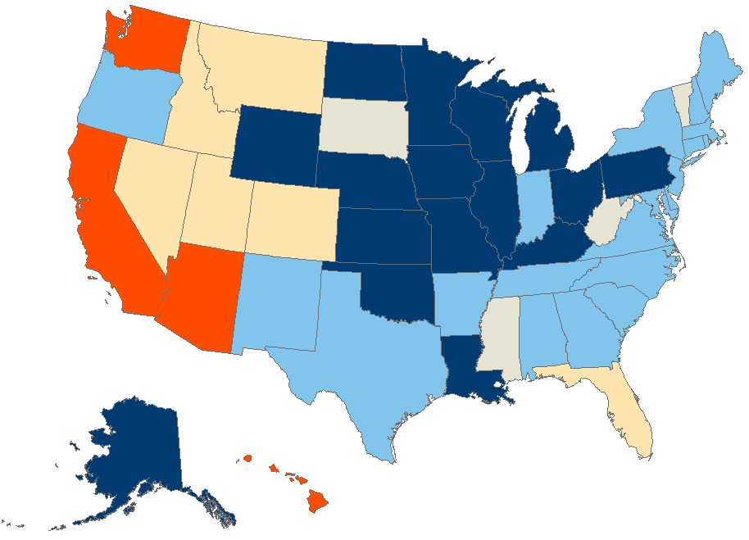
Homeowners in Much of the Country Continued to Benefit from Huge Equity Gains
Average Equity Gain (Dollars)
2020:4–2021:4
Under 30,000 (Down to 11,000)
30,000-59,999
60,000-89,999
90,000 and Over (Up to 128,000)
Source: CoreLogic Homeowner Equity Insights.
Insufficient Data

Slide 50
Unemployment Has Remained Low…
Percent
Source: Freddie Mac Primary Mortgage Market Survey

Slide 51
The Pace of Existing Home Sales Has Slowed Sharply
Source: JCHS tabulations of NAR data via Moody’s Analytics, Economy.com
Notes:
Soaring prices have kept many would-be homeowners in rental housing, contributing to the already strong growth in renter households.
Perhaps nowhere was the rebound in demand (and the imbalance between supply and demand) more apparent than in the apartment rental markets, as shown by this chart.
RealPage reports that net new leases for professionally managed apartment properties were up by 713,000 units in the first quarter of 2022 compared with a year earlier, the largest annual increase in net occupancy in records going back to 2000.
as RealPage data show, despite completions running at a robust 349,000 unit annual rate in the first quarter of 2022, the number of occupied apartments was rising at more than twice that pace
over 700,000 occupied rental apartments in in a single year.
It will take a significant increase in housing production for the rental supply to match such strong demand.

Slide 52
Some Efforts to Reduce Racial Homeownership Gaps
Targeted Downpayment Assistance
To first-generation homebuyers
Geographically
Special Purpose Credit Programs
Providing credit on favorable terms to borrowers of a protected class that has suffered economic disadvantages.
Homebuyer Education and Counseling
Funding to increase the supply of homes in communities of color

