Slide 1
How Have Renters Responded to Financial Stress During the Pandemic?
October 29, 2021
Whitney Airgood-Obrycki, Chris Herbert, Alexander Hermann, and Sophia Wedeen

Slide 2

Housing Crisis Research Collaborative (HCRC)
This work has been funded by the HCRC, a collaborative effort of four research centers with the goal of addressing the long-standing inequities in access to safe, stable, and affordable rental housing that have been laid bare by the COVID-19 pandemic
The HCRC provides policymakers at all levels of government with the data and analysis they need to design, implement, and evaluate more equitable and effective rental housing and community development responses to the pandemic and the ongoing rental housing affordability crisis
See https://housingcrisisresearch.org/ for more information on the collaborative and links to previous research

Slide 3
Research Questions
To what extent did renters who lost income rely on different resources – including public programs and personal financial resources – to meet their expenses?
How did use of these different financial resources vary by renters’ demographic characteristics?
To what extent was the use of these resources associated with falling behind on rent?

Slide 4
Key Takeaways
Large shares of renter households lost income and fell behind on rent during the pandemic
Whether behind on rent or not, households relied on a range of personal financial resources and policy supports to meet their expenses
The extent of the hardship that households experienced, as well as the financial resources they relied on, varied significantly by income and by race/ethnicity
Among households behind on rent, borrowing from friends and family and using SNAP benefits were both critical resources

Slide 5
Data and Methods

Slide 6
Household Pulse Survey
Strengths of this dataset:
  Frequency
  Timeliness
  Sample size
Weaknesses:
  Low response rates
  Questions don’t ask about magnitude
Study period: August 2020 through March 2021
Sample: 234,000 renter households including 113,000 that lost employment income

Slide 7
Household Pulse Survey: Key Indicators
Income Loss: “Have you, or has anyone in your household experienced a loss of employment income since March 13, 2020?”
Behind on Rent: “Is this household currently caught up on rent payments?”
Spending Sources: “Thinking about your experience in the last 7 days, which of the following did you or your household members use to meet your spending needs?”
  Regular income sources
  Credit cards or loans
  Money from savings or selling assets
  Borrowing from friends or family
  Unemployment insurance
  Stimulus payment
  Money saved from deferred or forgiven payments
  Supplemental Nutrition Assistance Program

Slide 8
Renters Hit Hard, Especially Lower-Income Households and Households of Color

Slide 9
Renter Households Were Especially Likely to Lose Income and Fall Behind on Housing Payments During Pandemic
Notes: Income losses occurred at any time during the pandemic. Households behind on rent reported that they were not caught up at the time of survey.
Source: JCHS tabulations of US Census Bureau Household Pulse Surveys, August 2020-March 2021

Slide 10
Lower-Income Renter Households Were More Likely to Lose Income and Fall Behind on Rent
Notes: Income losses occurred at any time during the pandemic. Households behind on rent reported that they were not caught up at the time of survey.
Source: JCHS tabulations of US Census Bureau Household Pulse Surveys, August 2020-March 2021

Slide 11
Renter Households of Color Were More Likely to Lose Income and Fall Behind on Rent
Notes: Income losses occurred at any time during the pandemic. Households behind on rent reported that they were not caught up at the time of survey.
Black, white, and Asian households are non-Hispanic. Hispanic households may be of any race.
Source: JCHS tabulations of US Census Bureau Household Pulse Surveys, August 2020-March 2021

Slide 12
Households That Lost Income Were More Likely to Fall Behind on Rent

Slide 13
Renter Households That Lost Income Were Three Times as Likely to Fall Behind on Rent
Notes: Income losses occurred at any time during the pandemic. Households behind on rent reported that they were not caught up at the time of survey.
Source: JCHS tabulations of US Census Bureau Household Pulse Surveys, August 2020-March 2021

Slide 14
Renters Have Responded to Income Loss by Tapping Other Resources to Meet Expenses

Slide 15
Households That Lost Income During the Pandemic Were Much More Likely to Rely on Other Sources to Meet Their Spending Needs
Notes: Income losses occurred at any time during the pandemic.
Source: JCHS tabulations of US Census Bureau Household Pulse Surveys, August 2020-March 2021

Slide 16
Households That Lost Income During the Pandemic Were Much More Likely to Rely on Other Sources to Meet Their Spending Needs
Notes: Income losses occurred at any time during the pandemic.
Source: JCHS tabulations of US Census Bureau Household Pulse Surveys, August 2020-March 2021

Slide 17
Households That Lost Income During the Pandemic Were Much More Likely to Rely on Other Sources to Meet Their Spending Needs
Notes: Income losses occurred at any time during the pandemic.
Source: JCHS tabulations of US Census Bureau Household Pulse Surveys, August 2020-March 2021

Slide 18
Households Behind on Rent Relied on a Different Set of Resources

Slide 19
Households That Fell Behind on Rent Were Much More Likely to Borrow From Friends/Family or Use SNAP to Meet Spending Needs
Notes: Includes only households that lost income. Income losses occurred at any time during the pandemic. Households behind on rent reported that they were not caught up at the time of survey.
Source: JCHS tabulations of US Census Bureau Household Pulse Surveys, August 2020-March 2021

Slide 20
Households That Fell Behind on Rent Were Much More Likely to Borrow From Friends/Family or Use SNAP to Meet Spending Needs
Notes: Includes only households that lost income. Income losses occurred at any time during the pandemic. Households behind on rent reported that they were not caught up at the time of survey.
Source: JCHS tabulations of US Census Bureau Household Pulse Surveys, August 2020-March 2021

Slide 21
Households That Fell Behind on Rent Were Much More Likely to Borrow From Friends/Family or Use SNAP to Meet Spending Needs
Notes: Includes only households that lost income. Income losses occurred at any time during the pandemic. Households behind on rent reported that they were not caught up at the time of survey.
Source: JCHS tabulations of US Census Bureau Household Pulse Surveys, August 2020-March 2021

Slide 22
Resource Use Varied by Income and Race/Ethnicity

Slide 23
Among Households Behind on Rent, Lower-Income Households Were More Likely to Borrow or use SNAP to Meet Their Spending Needs
Notes: Sample is households who lost income and fell behind on rent. Income losses occurred at any time during the pandemic. Households behind on rent reported that they were not caught up at the time of survey.
Source: JCHS tabulations of US Census Bureau Household Pulse Surveys, August 2020-March 2021

Slide 24
Among Households Behind on Rent, Households of Color Were Less Likely to Rely on Regular Income Sources and Savings
Notes: Sample is households who lost income and fell behind on rent. Income losses occurred at any time during the pandemic. Households behind on rent reported that they were not caught up at the time of survey. Black, white, and Asian households are non-Hispanic. Hispanic households may be of any race.
Source: JCHS tabulations of US Census Bureau Household Pulse Surveys, August 2020-March 2021

Slide 25
Multivariate Analysis Finds That Households with Regular Income and Savings Were More Likely to Make Rent

Slide 26
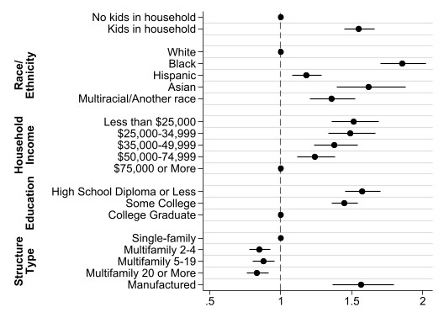
Logit Model Confirms Descriptive Findings
Outcome: Behind on rent
Sample: Renters who lost employment income since start of pandemic
Odds Ratio
Source: JCHS analysis of US Census Bureau Household Pulse Surveys, August 2020-March 2021

Slide 27
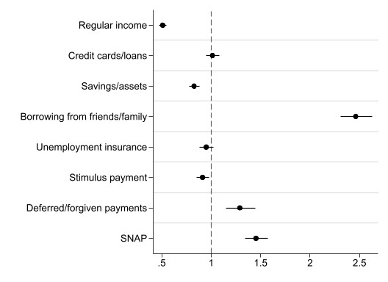
Regular Income, Savings, and Stimulus Payments Were Associated with Lower Likelihood of Missing Rent
Outcome: Behind on rent
Sample: Renters who lost employment income since start of pandemic
Odds Ratio
Source: JCHS analysis of US Census Bureau Household Pulse Surveys, August 2020-March 2021

Slide 28
Conclusions and Implications

Slide 29
Policy Implications
Federal aid, including SNAP, stimulus payments, and unemployment insurance remain critical pillars of support, particularly for lowest-income households
Extremely low-income households who received SNAP, stimulus checks, etc. still tapped other resources and borrowed from friends or family, which suggests that these programs are not fully meeting their needs
For the many households that lost income but did not fall behind on rent, the financial impact of the pandemic still includes a loss of savings and higher debt levels, pointing to the need for financial supports that go beyond emergency rental assistance to address the pandemic's financial impacts
Low-income renters were more likely to borrow from family and friends, pointing to the radiating of the financial impacts beyond those directly impacted

Slide 30
The Need for Better Data
Gaps in data remain:
Magnitude of income losses
Magnitude of rent arrears
Magnitude of reductions in savings
Evictions
Repayment plans with landlords
Housing disaggregated by tenure, race, ethnicity, income, etc.

Slide 31
Thank You
sophia_wedeen@harvard.edu

Slide 32
Among Renter Households That Lost Income, Lower-Income Households Were More Likely to Fall Behind on Rent
Notes: Income losses occurred at any time during the pandemic. Households behind on rent reported that they were not caught up at the time of survey.
Source: JCHS tabulations of US Census Bureau Household Pulse Surveys, August 2020-March 2021

Slide 33
Among Renter Households That Lost Income, Black Households Were The Most Likely to Fall Behind on Rent
Notes: Income losses occurred at any time during the pandemic. Households behind on rent reported that they were not caught up at the time of survey. Black, white, and Asian households are non-Hispanic. Hispanic households may be of any race.
Source: JCHS tabulations of US Census Bureau Household Pulse Surveys, August 2020-March 2021

Slide 34
Households Behind on Rent Used More Spending Sources But Still Fell Short
Notes: Spending sources include credit cards/loans, savings/assets, borrowing from friends/family, unemployment insurance, stimulus payments, and money from deferred/forgiven payments. Sample is households who lost income.
Source: JCHS tabulations of US Census Bureau Household Pulse Surveys, August 2020-March 2021

Slide 35
Lower-Income Households Who Were Behind on Rent May Have Had Fewer Resources to Tap
Notes: Spending sources include credit cards/loans, savings/assets, borrowing from friends/family, unemployment insurance, stimulus payments, and money from deferred/forgiven payments. Sample is households who lost income.
Source: JCHS tabulations of US Census Bureau Household Pulse Surveys, August 2020-March 2021

Slide 36
Among Households That Lost Income, Those That Fell Behind on Rent Were More Likely to Tap Into Policy Sources to Meet Their Spending Needs
Notes: Personal sources include regular income, credit cards/loans, savings/assets, borrowing from friends/family. Policy sources include unemployment insurance, stimulus payments, money from deferred/forgiven payments, and SNAP. Combined Sources are at least one personal resource and at least one policy source. Sample is all renter households.
Source: JCHS tabulations of US Census Bureau Household Pulse Surveys, August 2020-March 2021

