Slide 1
Improving America’s Housing 2021 Figures
March 25, 2021

Slide 2
Figure 1: The Home Remodeling Market Is Continuing Its Steady Expansion Despite the Pandemic
Note: Estimated (e) and forecasted (f) values are modeled using the 2020:Q4 Leading Indicator of Remodeling Activity (LIRA).
Source: JCHS analysis of US Department of Housing and Urban Development (HUD), American Housing Surveys; US Department of Commerce, Retail Sales of Building Materials; US Census Bureau, Surveys of Residential Alterations and Repairs (C-50); National Apartment Association (NAA), Surveys of Operating Income & Expenses; and LIRA.

Slide 3
Figure 2: While Replacement Projects Still Account for About Half of Homeowner Expenditures, Property Improvements and Disaster Repairs Have Become a Growing Share
Notes: Replacement projects include exterior, systems and equipment, and interior projects. Discretionary projects include kitchen and bath remodels, room additions, and outside attachments. Outside property includes such projects as driveways and walkways, fencing, sheds, landscaping, and recreational structures. See Table A-1 for more detailed definitions of project categories.
Source: JCHS tabulations of HUD, American Housing Surveys.

Slide 4
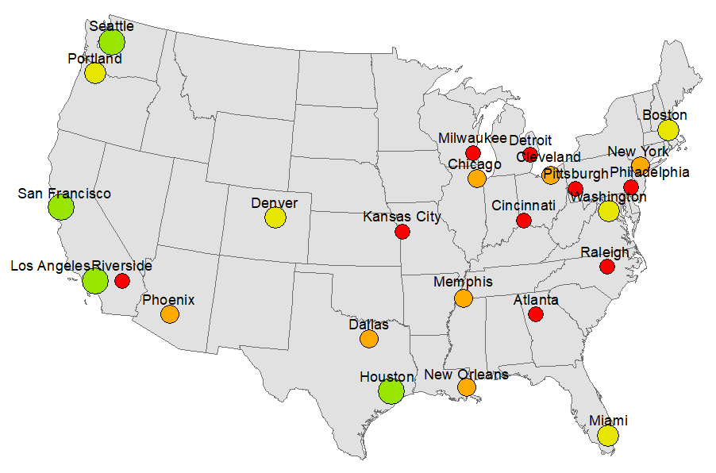
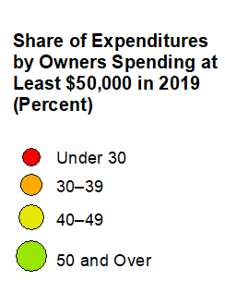
Figure 3: In Most Higher-Cost Metros, Top-Spending Homeowners Make Up 40 Percent or More of the Improvement Market
Notes: Data are for 25 metros available in the 2019 AHS, including the 15 largest by population. See Table A-3 for more detailed data on spending concentration and median incomes and home values.
Source: JCHS tabulations of HUD, American Housing Survey.

Slide 5
Figure 4: Although DIY Improvement Spending Was Up in 2019, Its Share of the Market Dropped to a New Low
Source: JCHS tabulations of HUD, American Housing Surveys.

Slide 6
Figure 5: Older Owners Continue to Increase Their Share of Home Improvement Spending
Source: JCHS tabulations of HUD, American Housing Surveys.

Slide 7
Figure 6: Over a Third of Owners Spent Little or Nothing to Maintain or Improve Their Homes in 2019
Source: JCHS tabulations of HUD, 2019 American Housing Survey.

Slide 8
Figure 7: Professional Remodeling Activity Gradually Recovered in 2020 from a Pandemic-Induced Drop, While Sales of Home Improvement Products Rebounded Much More Sharply
Notes: Aggregate hours worked is the product of number of payroll employees and average weekly hours worked. Building materials and supplies dealers include home centers, paint and wallpaper stores, and hardware stores.
Source: JCHS tabulations of US Bureau of Labor Statistics, Current Employment Statistics and US Department of Commerce, Monthly Retail Trade Survey.

Slide 9
Figure 8: Remodeling Activity Picked Up Last Year in Many Metros with Larger Shares of Younger Owners
Notes: Data are for 47 of the largest metros by population with sufficient permit reporting coverage. Share of owners under age 35 is for 2019. The metro average change in permitted properties is -0.1%, and the average share of homeowners under age 35 is 11.4%. See Table A-5 for more detailed data.
Source: JCHS tabulations of BuildFax and US Census Bureau, 2019 American Community Survey.

Slide 10
Figure 9: Lowest-Income Owners Spend a Much Larger Share of Their Improvement Budgets on Replacement Projects than Highest-Income Owners
Share of Spending, 2019
Notes: See Table A-1 for more detailed definitions of project categories. Kitchen and bath remodels include additions. The bottom income quintile includes household incomes of less than $32,000 and the top quintile includes incomes of more than $144,000.
Source: JCHS tabulations of HUD, 2019 American Housing Survey.

Slide 11
Figure 10: Improvement Spending Varies Considerably with Housing Tenure and Type
Notes: Estimates are average per-unit spending in 2019. Single-family homes are detached. Spending on rented units is by owners of the property.
Source: JCHS analysis of HUD, 2019 American Housing Survey and NAA, 2020 Survey of Operating Income & Expenses.

