Slide 1
SON 2022-Figure Data (Public)
June 13, 2022

Slide 2
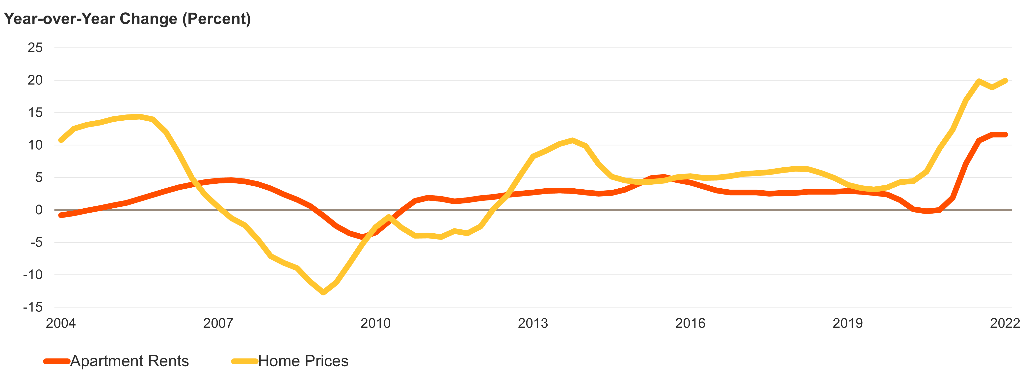
Figure 1: Home Prices and Apartment Rents Soared to New Heights in 2021
Note: CoStar same-store rents are for professionally managed market-rate apartments in buildings with five or more units.
Source: JCHS tabulations of CoStar data; S&P CoreLogic Case-Shiller US National Home Price Index.

Slide 3
Figure 2: Household Growth Has Remained Strong Despite the Pandemic
Source: JCHS tabulations of US Census Bureau, Housing Vacancy Surveys.

Slide 4
Figure 3: Higher Interest Rates Have Raised Payments on Median-Priced Homes by Over $600 a Month
Note: Monthly mortgage payments include principal and interest only and assume a 3.5% downpayment on a 30-year fixed-rate loan with no points.
Source: JCHS tabulations of Freddie Mac, Primary Mortgage Market Surveys; National Association of Realtors (NAR), Existing Home Sales.

Slide 5
Figure 4: Record Numbers of Homes Are Currently Under Construction
Source: JCHS tabulations of US Census Bureau, New Residential Construction data.

Slide 6
Figure 5: Cost Burdens Are Widespread among Renters, Lower-Income Households, and Households of Color
Tenure
Household Income
Race/Ethnicity
Notes: Moderately (Severely) cost-burdened households spend 30–50% (more than 50%) of incomes on housing costs. Black, Asian, and white householders are non-Hispanic. Hispanic householders may be of any race(s).
Source: JCHS tabulations of US Census Bureau, 2020 American Community Survey 1-Year Estimates using experimental weights.

Slide 7
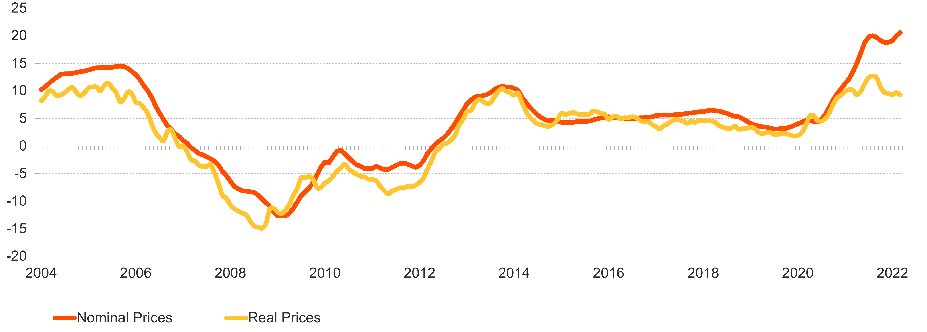
Figure 6: Home Price Appreciation Set New Records in the Past Year
Annual Change (Percent)
Note: Real home prices are adjusted for inflation using the CPI-U for All Items less shelter.
Source: JCHS tabulations of S&P CoreLogic Case-Shiller US National Home Price Index.

Slide 8
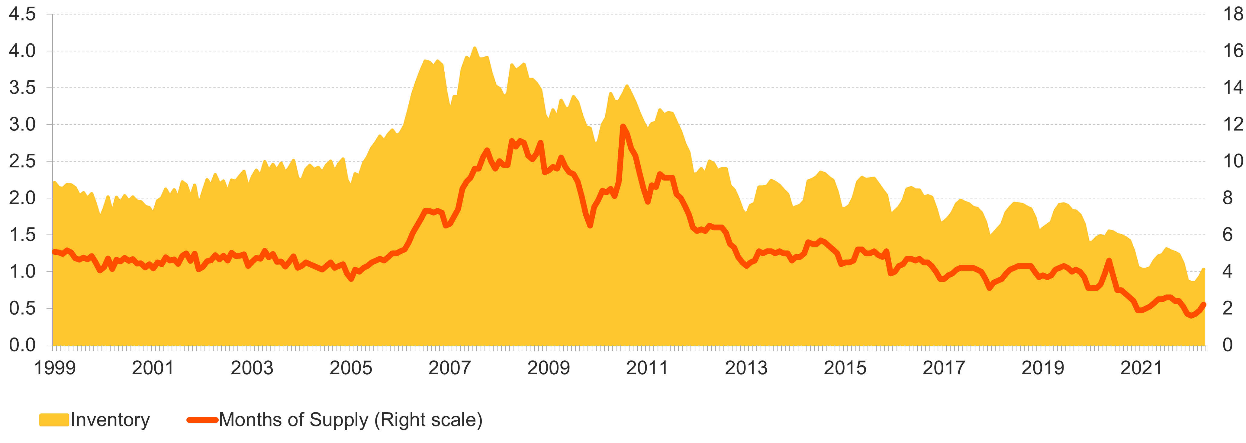
Figure 7: The Supply of Homes on the Market Has Reached New Lows
Existing Homes for Sale (Millions)
Months of Supply
Note: Months of supply measure how long it would take homes on the market to sell at the current rate, where six months are typically considered a balanced market.
Source: JCHS tabulations of NAR, Existing Home Sales.

Slide 9
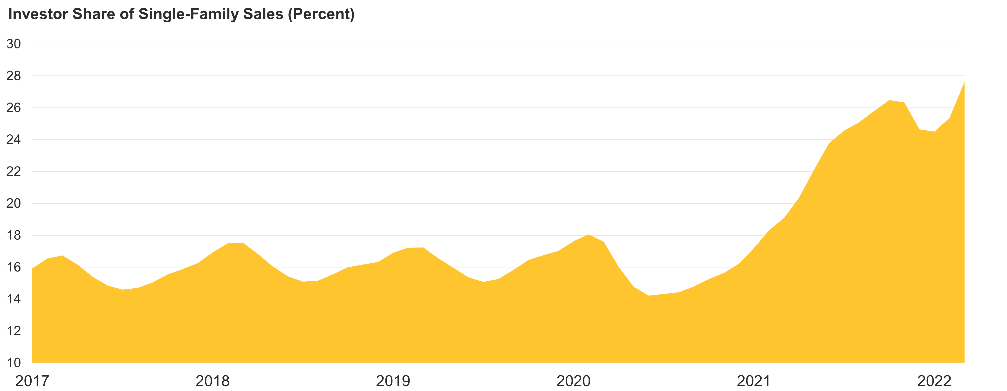
Figure 8: Investors Are Buying Up a Record Share of Single-Family Homes
Note: Data are 3-month trailing averages.
Source: JCHS tabulations of CoreLogic data.

Slide 10
Figure 9: New Construction Picked Up Last Year and Remains on a Strong Upward Trend
Note: Housing starts for 2022 are the average of the seasonally adjusted annual rate for January–April.
Source: JCHS tabulations of US Census Bureau, New Residential Construction data.

Slide 11
Figure 10: Costs of Building Materials Have Soared Since the Start of the Pandemic
Note: Inputs to new residential construction are not a composite of the other components, and exclude capital, labor, and imports.
Source: JCHS tabulations of US Bureau of Labor Statistics, Producer Price Indexes.

Slide 12
Figure 11: Household Growth among Adults in Their Mid-30s to Mid-40s Has Picked Up Pace
Age of Household Head
Source: JCHS tabulations of US Census Bureau, Housing Vacancy Surveys.

Slide 13
Figure 12. Steep Declines in Both Immigration and Natural Population Change Have Pulled Down US Population Growth
Note: Natural population change is the difference between births and deaths.
Source: JCHS tabulations of US Census Bureau, Population Estimates Program.

Slide 14
Figure 13: People of Color Have Driven Most of Household Growth for a Decade and Now Account for a Third of Households
Race/Ethnicity of Household Head
Notes: Black, multiracial, white, and Asian or another race householders are non-Hispanic. Hispanic householders may be of any race(s).
Source: JCHS tabulations of US Census Bureau, Housing Vacancy Surveys.

Slide 15
Figure 14: Even If They Own Homes, Black and Hispanic Households Have Significantly Less Wealth than White Homeowners
Notes: Black, white, and Asian or another race(s) householders are non-Hispanic. Hispanic householders may be of any race(s).
Source: JCHS tabulations of Federal Reserve Board, 2019 Survey of Consumer Finances.

Slide 16
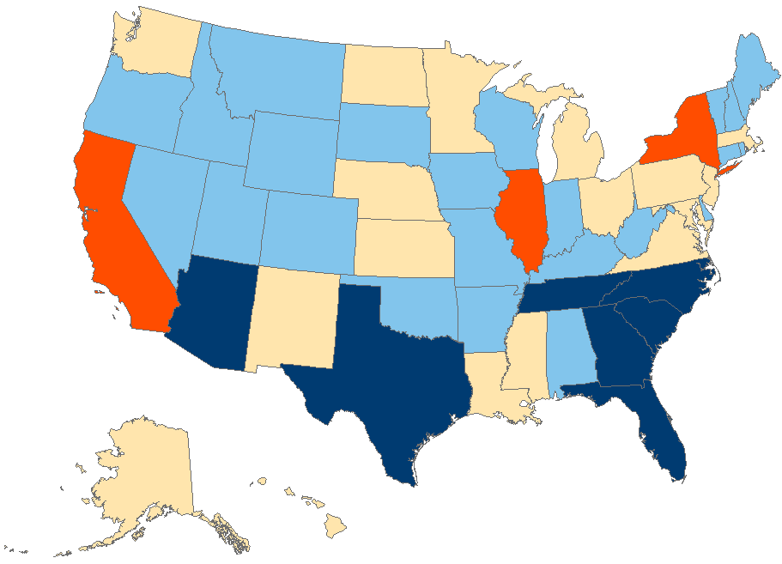
Figure 15: Domestic Migration Gave a Big Lift to Population Growth in Many Sunbelt States in 2021
Source: JCHS tabulations of US Census Bureau, 2021 Population Estimates Program.

Slide 17
Figure 16: The Number of Homeowners Continued to Climb in Early 2022
Homeowners (Millions)
Homeownership Rate (Percent)
Source: JCHS tabulations of US Census Bureau, Housing Vacancy Surveys.

Slide 18
Figure 17: Recent Interest Rate Hikes Have Further Eroded Affordability
 | April 2021 | April 2022 | Change 2021-2022
Interest Rate (Percent) | 3.06 | 4.98 | 1.92
Median Home Price (Dollars) | 340,700 | 391,200 | 50,500
Downpayment & Closing Costs | 22,100 | 25,400 | 3,300
Monthly Mortgage Payment | 1,400 | 2,020 | 630
Total Monthly Owner Costs | 2,060 | 2,780 | 720
Annual Income Needed | 79,600 | 107,600 | 28,000
Note: Estimates assume a 3.5% downpayment on a 30-year fixed-rate loan with zero points, 0.85% mortgage insurance, 0.35% property taxes, 1.15% property taxes, 3% closing costs, and a maximum 31% debt-to-income ratio.
Source: JCHS tabulations of Freddie Mac, Primary Mortgage Market Surveys; NAR, Existing Home Sales.

Slide 19
Figure 18: Regardless of Income, Households of Color Have Lower Homeownership Rates than White Households
Homeownership Rate (Percent)
Race/Ethnicity
Notes: White, Native American, Asian, and Black householders are non-Hispanic. Hispanic householders may be of any race(s).
Source: JCHS tabulations of US Census Bureau, 2019 American Community Survey 1-Year Estimates.

Slide 20
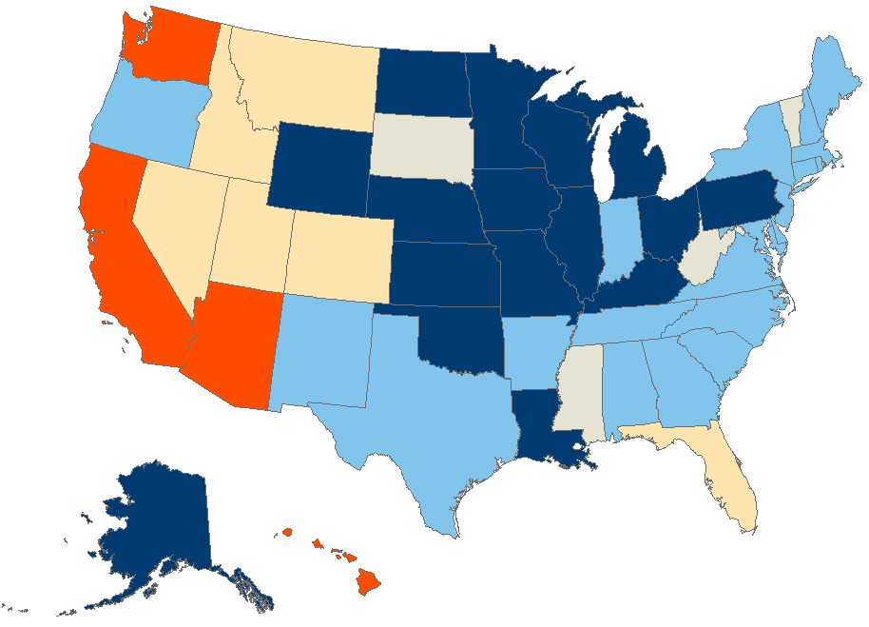
Figure 19: Homeowners in Much of the Country Benefited from Huge Equity Gains in Just One Year
Average Equity Gain (Dollars)
2020:4–2021:4
Under 30,000 (Down to 11,000)
30,000-59,999
60,000-89,999
90,000 and Over (Up to 128,000)
Insufficient Data
Source: CoreLogic Homeowner Equity Insights.

Slide 21
Figure 20: Lower-Income Homeowners and Homeowners of Color Were More Likely to Be Behind on Their Mortgage Payments in Early 2022
Share of Homeowners Behind on Mortgage Payments (Percent)
Household Income
Race/Ethnicity
Notes: Households behind on their mortgages reported that they were not caught up at the time of the survey. Black, Asian, and white householders are non-Hispanic. Hispanic householders may be of any race(s).
Source: JCHS tabulations of US Census Bureau, Household Pulse Surveys, December 2021–April 2022.

Slide 22
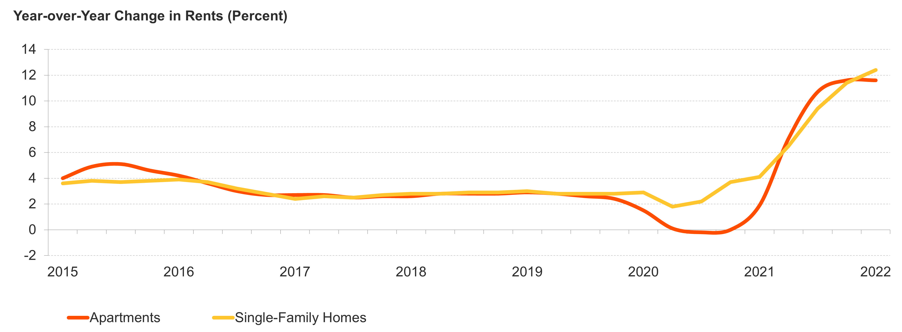
Figure 21: Rents for Both Apartments and Single-Family Homes Have Surged
Notes: Single-family rent increases in 2022:1 are for January and February alone. CoStar same-store rents are for professionally managed market-rate apartments in buildings with five or more units.
Source: JCHS tabulations of CoStar data; CoreLogic Single-Family Rent Index.

Slide 23
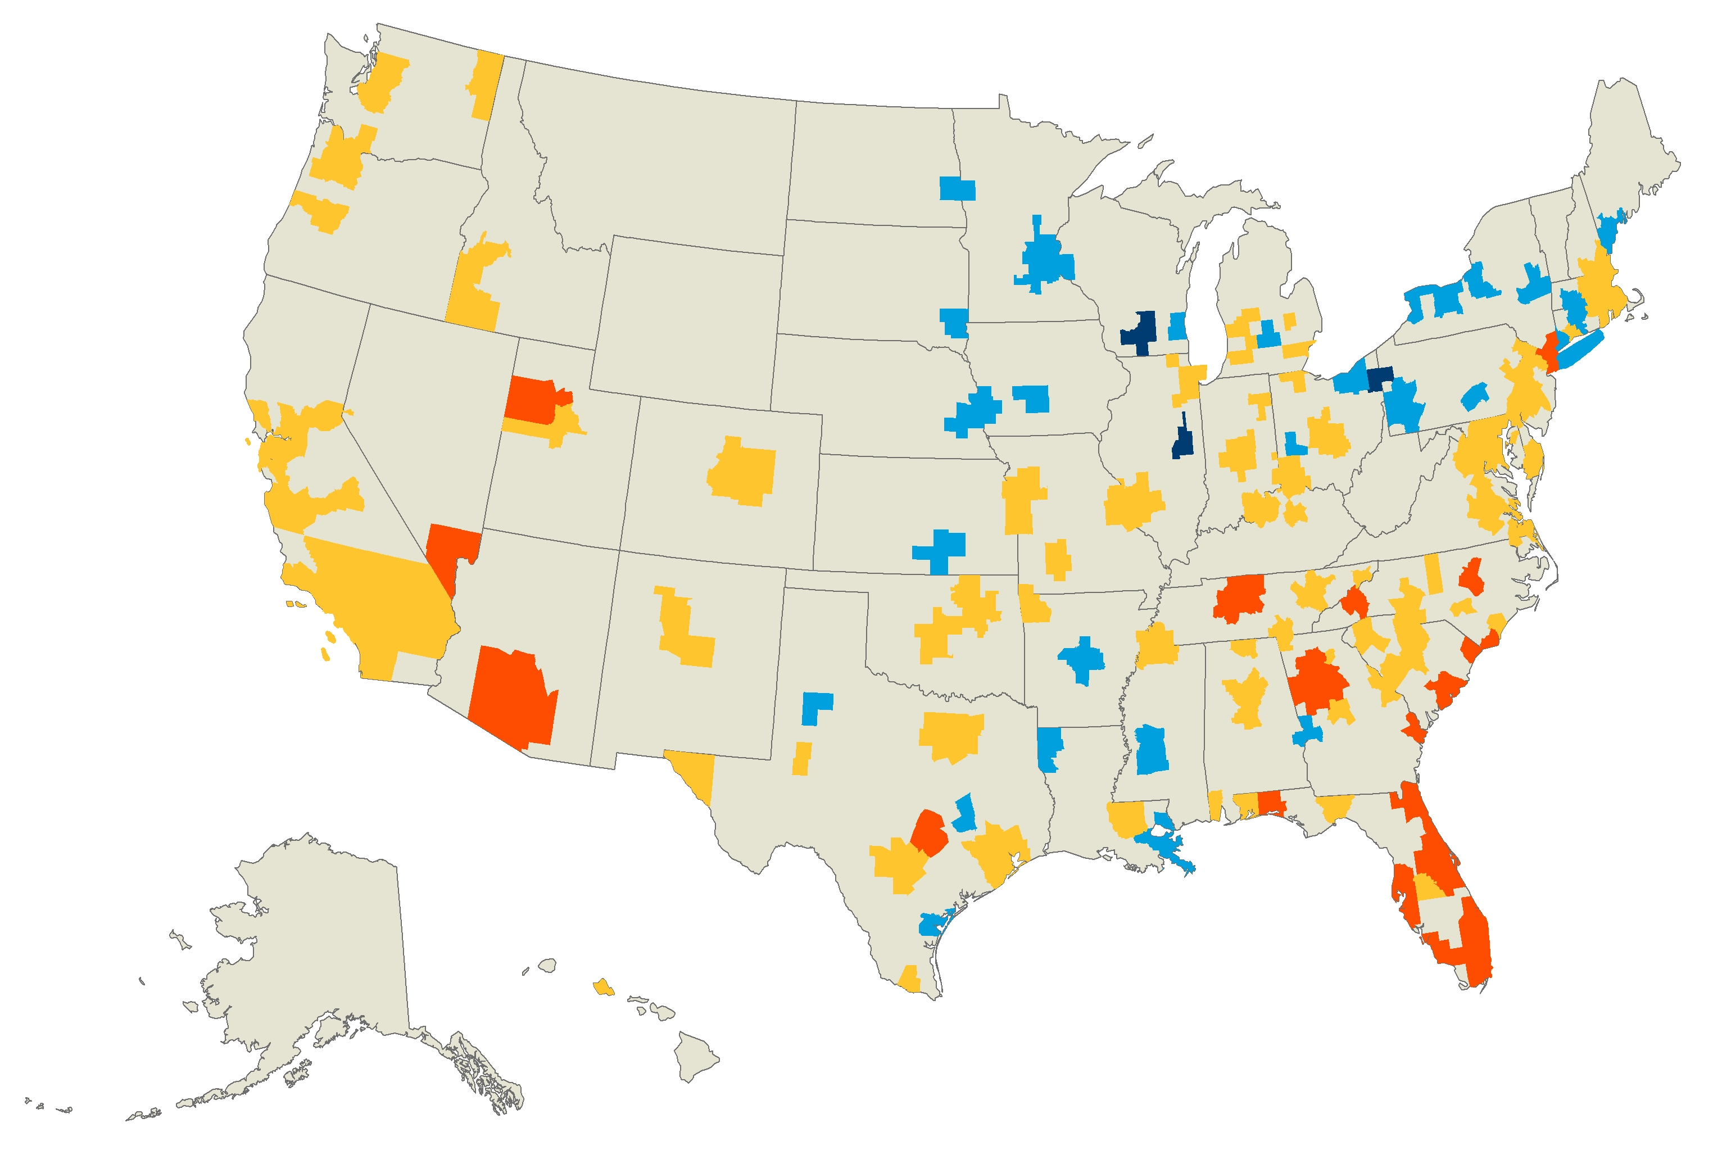

Figure 22: Rents in Most Major Markets Were Up by Double Digits in Early 2022
Change in Asking Rents
2021:1–2022:1 (Percent)
Under 5.0 (Down to 1.0)
5.0–9.9
10.0–19.9
20.0 and Over (Up to 42.0)
Note: Asking rents are for professionally managed apartments in buildings with five or more units in the 150 markets that RealPage tracks.
Source: JCHS tabulations of RealPage data.

Slide 24
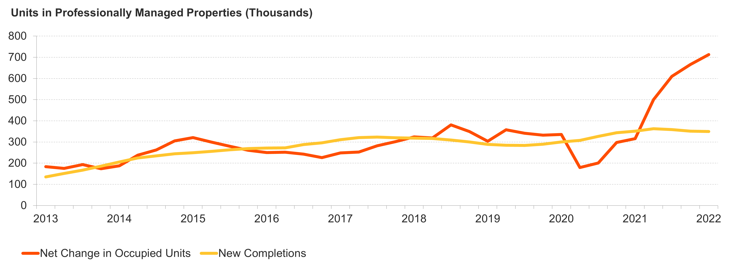
Figure 23: Growth in Apartment Demand Far Outpaced Additions to Supply Over the Past Year
Note: Data are 4-quarter rolling averages for professionally managed apartment properties with five or more units.
Source: JCHS tabulations of RealPage data.

Slide 25
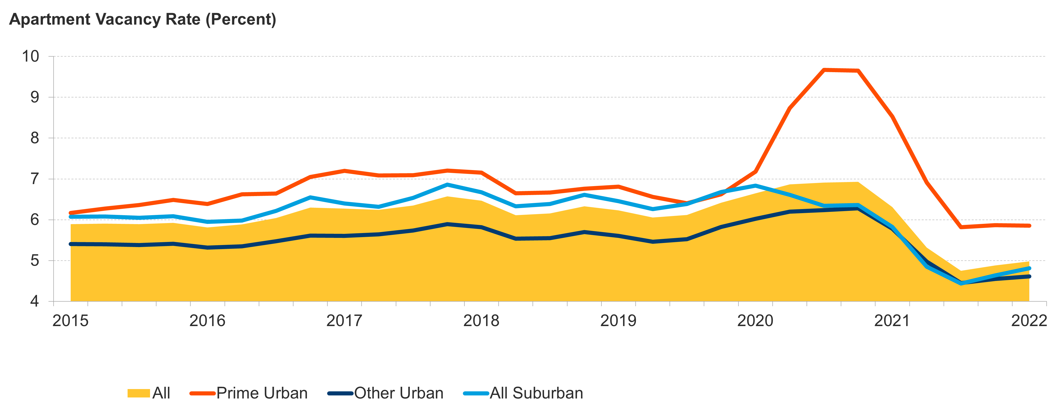
Figure 24: Vacancy Rates Have Fallen Back Near Historic Lows Even in Prime Urban Areas
Submarket
Notes: Urban/suburban areas are based on density in the 54 largest markets that CoStar tracks. Prime submarkets have the highest rents.
Source: JCHS tabulations of CoStar data.

Slide 26
Figure 25: Many Lower-Income Households and Households of Color Still Struggled to Pay Rent in Early 2022
Notes: Households behind on rent reported that they were not caught up at the time of the survey. Black, Asian, and white householders are non-Hispanic. Hispanic householders may be of any race(s).
Source: JCHS tabulations of US Census Bureau, Household Pulse Surveys, December 2021–April 2022.

Slide 27
Figure 26: Cost Burden Rates Increased for Households at All Income Levels in 2020
Share of Households with Cost Burdens (Percent)
Notes: Incomes are adjusted for inflation using the CPI-U for All Items. Cost-burdened households pay more than 30% of income for housing.
Source: JCHS tabulations of US Census Bureau, American Community Survey 1-Year Estimates using experimental weights.

Slide 28
Figure 27: Evictions Were Back Near Pre-Pandemic Levels in Early 2022
Note: Data include eviction filings in six states and 31 cities.
Source: JCHS tabulations of Eviction Lab, Eviction Tracking System through March 31, 2022.

Slide 29
Figure 28: Outlays for Emergency Rental Assistance Nearly Equaled HUD’s 2021 Budget
Note: State and local fiscal recovery fund allocations are the estimated amounts to be spent on housing-related activities.
Sources: Brookings Institution, Local Government ARPA Investment Tracker; National Council of State Housing Agencies; US Department of Treasury; and National Low Income Housing Coalition.

Slide 30
Figure 29: Adults in Their 80s Are Much More Likely to Have Difficulties Using or Navigating Their Homes
Age of Household Head
Note: Difficulties are defined as challenges with entering, navigating, or using the home without assistance.
Source: JCHS tabulations of US Department of Housing and Urban Development (HUD), American Housing Surveys.

Slide 31
Figure 30: Homeowner Spending on Disaster Repairs Is Trending Up
Average (Thousands of dollars)
Notes: Annual expenditures are adjusted to 2019 dollars using the CPI-U for All Items. Average expenditures are outlays per homeowner that spent on disaster repairs.
Source: JCHS tabulations of HUD, 2019 American Housing Survey.

