Slide 1
America’s Rental Housing 2024

Slide 2
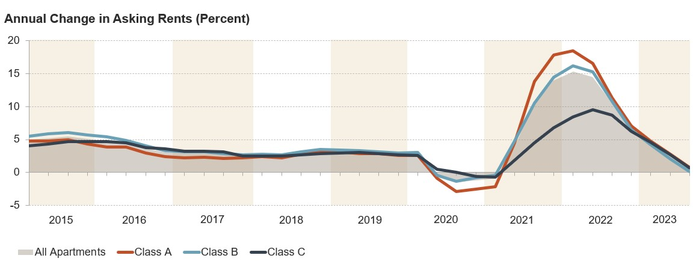
Figure 1: Apartment Rent Growth Has Stalled
Notes: Asking rents are for professionally managed apartments in buildings with five or more units. Class A (Class C) apartments are relatively higher (lower) quality. Source: RealPage.

Slide 3
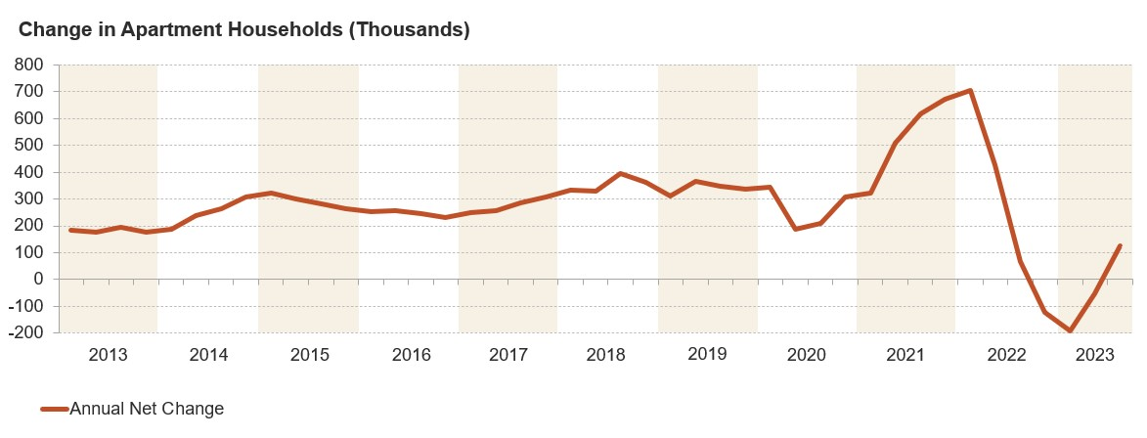
Figure 2: Apartment Demand Has Started to Rebound
Note: Annual net change is the four-quarter rolling total for professionally managed apartment buildings with five or more units.
Source: RealPage.

Slide 4
Figure 3: The Number of Cost Burdened Renters Hit an All-Time High
Share with Cost Burdens (Percent)
Notes: Moderately (severely) cost-burdened households spend 30–50% (more than 50%) of income on rent and utilities. Households with zero or negative income are assumed to have burdens, and households that are not required to pay rent are assumed to be unburdened. Estimates for 2020 are omitted because of data collection issues experienced during the pandemic.
Source: JCHS tabulations of US Census Bureau, American Community Survey 1-Year Estimates.

Slide 5
Figure 4: After a Swift Uptick in 2023, a Record Number of People Are Unhoused
Note: Because of the pandemic, complete unsheltered counts were unavailable in January 2021 and sheltered counts were artificially low, likely because of reduced shelter capacity. Data for 2021 are based on 2020 and 2022 values.
Source: JCHS tabulations of US Department of Housing and Urban Development, Annual Homeless Assessment Report Point-in-Time Estimates.

Slide 6
Figure 5: The Rental Assistance Shortage Continues to Worsen
2001
2021
Notes: Severe problems include spending more than 50% of income on rent and utilities or living in severely inadequate housing. Moderate problems include spending 30–50% of income on rent and utilities or living in moderately inadequate housing.
Source: JCHS tabulations of US Department of Housing and Urban Development, Worst Case Housing Needs Reports to Congress.

Slide 7
Figure 6: New Multifamily Construction Has Quickly Declined
Note: Data are for buildings with at least two units and are through October 2023.
Source: JCHS tabulations of US Census Bureau, New Residential Construction data.

Slide 8
Figure 7: The Number of Renter Households Is Trending Upward Despite Declining Rentership Rates
Note: Values for 2023 are year-to-date averages for the first three quarters. Values for 2020 are omitted because data collection was disrupted during the pandemic.
Source: JCHS tabulations of US Census Bureau, Housing Vacancy Surveys.

Slide 9
Figure 8: Less Affluent, Smaller Households Boosted Pandemic-Era Renter Growth
Note: Household incomes are adjusted for inflation using the CPI-U for All Items.
Source: JCHS tabulations of US Census Bureau, American Community Survey 1-Year Estimates.

Slide 10
Figure 9: New Rental Demand Has Shifted from Millennials to Gen Z
Note: Data for 2020 are based on 2019 and 2021 values because of pandemic data disruptions.
Source: JCHS tabulations of US Census Bureau, American Community Survey 1-Year Estimates.

Slide 11
Figure 10: Households with Higher Incomes Have Fueled Long-Term Demand
Note: Household incomes are adjusted for inflation using the CPI-U for All Items.
Source: JCHS tabulations of US Census Bureau, American Community Survey 1-Year Estimates.

Slide 12
Figure 11: Lower-Income Renters Are More Likely to Be Older and Live Alone
Age
Notes: Lower-income households earn less than $30,000. Higher-income households earn at least $75,000. Age is for the household head. Other family households include single parents.
Source: JCHS tabulations of US Census Bureau, 2022 American Community Survey 1-Year Estimates.

Slide 13
Figure 12: Larger Buildings Account for Most of the Rental Stock Growth
Number of Rental Units (Millions)
Notes: Rental units may be occupied, vacant for rent, or rented but unoccupied. Single-family homes include attached and detached units. Data for 2020 are based on 2019 and 2021 values because of pandemic data disruptions.
Source: JCHS tabulations of US Census Bureau, American Community Survey 1-Year Estimates.

Slide 14
Figure 13:The Stock of Low-Rent Units Is Shrinking
Notes: Rents are adjusted for inflation using the CPI-U Less Shelter. Units that are occupied but do not receive payment are excluded. Contract rents exclude utility costs.
Source: JCHS tabulations of US Census Bureau, American Community Survey 1-Year Estimates.

Slide 15
Figure 14: The Rental Stock Varies Widely Across Markets, with Low-Rent Units More Common in Nonmetropolitan Areas
Notes: Only occupied rental units are depicted. Manufactured housing includes other structures such as boats and RVs. Contract rents exclude utility costs. Urban and suburban tracts fall within metropolitan statistical areas. Nonmetropolitan tracts fall outside of metropolitan areas.
Source: JCHS tabulations of US Census Bureau, 2021 American Community Survey 5-Year Estimates.

Slide 16
Figure 15: Renters with Lower Incomes and Those of Color Disproportionately Live in Inadequate Housing
Notes: Housing inadequacy refers to a variety of structural deficiencies, such as large holes and leaks or the absence of basic features including plumbing, electricity, water, or heat. HUD classifies units as moderately or severely inadequate depending on the type and number of these physical problems. Black, white, and Asian householders are non-Hispanic. Hispanic householders may be of any race.
Source: JCHS tabulations of US Department of Housing and Urban Development, 2021 American Housing Survey.

Slide 17
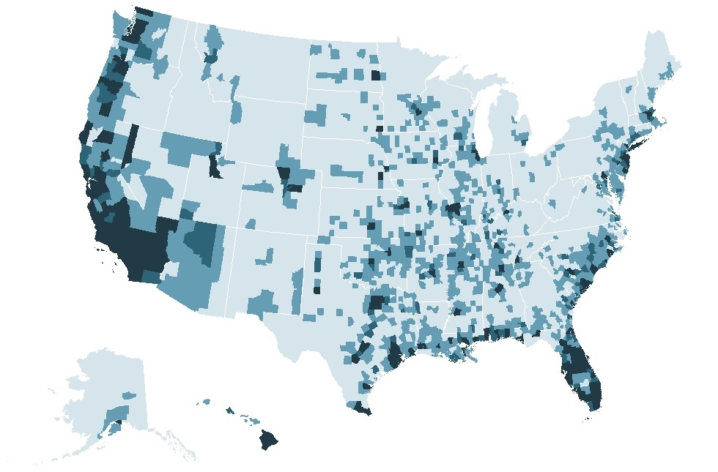
Figure 16: More Than 18 Million Rental Units Are Under Threat from Environmental Hazards
Number of Rental Units
In High-Risk Counties
Under 2,000
2,000–9,999
10,000–19,999
20,000 and Over (Up to 1.6 Million)
Notes: High-risk areas have a relatively moderate, relatively high, or very high expected annual loss (EAL) score. EAL represents the average economic loss in dollars resulting from natural hazards each year.The number of units in high-risk counties is aggregated from the tract level.
Source: JCHS tabulations of Federal Emergency Management Agency, July 2023 National Risk Index EAL data, and US Census Bureau, 2021 American Community Survey 5-Year Estimates.

Slide 18
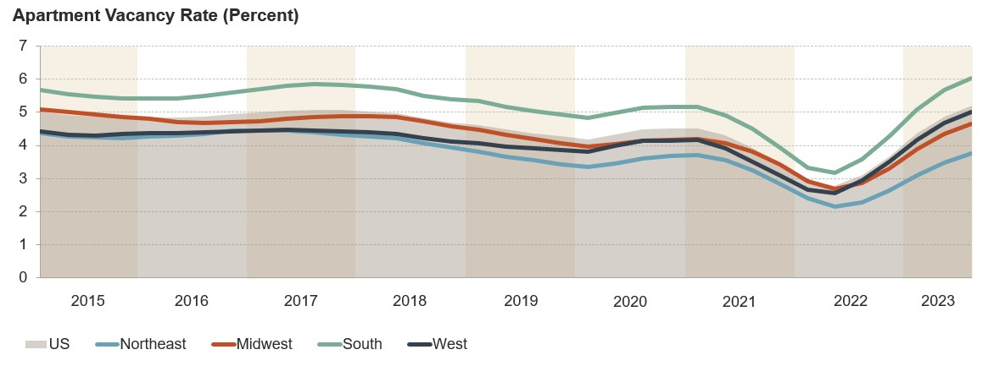
Figure 17: Apartment Vacancy Rates Are Rising Everywhere, Most Dramatically in the South
Note: Vacancy rates are four-quarter trailing values for professionally managed market-rate apartments in buildings with five or more units.
Source: JCHS tabulations of RealPage data.

Slide 19
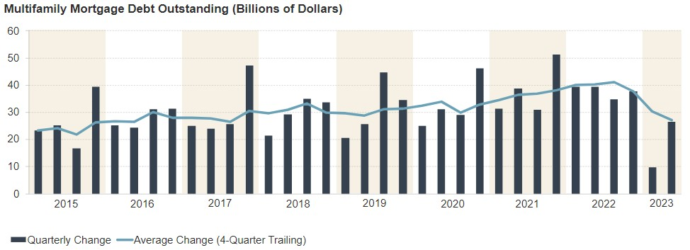
Figure 18: Multifamily Mortgage Flows Are Slowing
Source: JCHS tabulations of Mortgage Bankers Association data.

Slide 20
Figure 19: Completions Remain High and a Record Number of Units Are Under Construction
Note: Data for 2023 represent the seasonally adjusted year-to-date average through October.
Source: JCHS tabulations of US Census Bureau, New Residential Construction data.

Slide 21
Figure 20: Apartment Property Prices Have Fallen from Record Highs
Index Value
2015
2016
2017
2018
2019
2020
2021
2022
2023
Note: Apartment prices are indexed to January 2015. Indexed values represent cumulative percent change.
Source: JCHS tabulations of Real Capital Analytics, Commercial Property Price Indexes.

Slide 22
Figure 21: Nonindividual Investors Own a Growing Share of Rental Properties
Note: Nonindividual investors include partnerships, trustees for estate, real estate corporations, real estate investment trusts, nonprofit organizations, and other entities. .
Source: JCHS tabulations of US Census Bureau, Rental Housing Finance Surveys.

Slide 23
Figure 22: Cost Burdens Continued to Increase Across Incomes During the Pandemic
Under $30,000
$30,000–$44,999
$45,000–$74,999
$75,000 and Over
All Renter Households
Notes: Household incomes are adjusted for inflation using the CPI-U for All Items. Moderately (severely) cost-burdened households spend 30–50% (more than 50%) of income on rent and utilities. Households with zero or negative income are assumed to have severe burdens, while households that are not required to pay rent are assumed to be unburdened.
Source: JCHS tabulations of US Census Bureau, American Community Survey 1-Year Estimates.

Slide 24
Figure 23: Fully Employed Renters in a Range of Occupations Are Cost Burdened
Notes: Fully employed householders reported working at least 35 hours per week for at least 50 weeks of the previous year. All occupations includes households in occupations not shown. Cost-burdened households spend more than 30% of income on rent and utilities. Households with zero or negative income are assumed to be burdened, while households that are not required to pay rent are assumed to be unburdened.
Source: JCHS tabulations of US Census Bureau, 2022 American Community Survey 1-Year Estimates.

Slide 25
Figure 24: More Than a Third of Renters Are Cost Burdened in Every State in the Country
Share of Renters
With Cost Burdens(Percent)
37.0–39.9
40.0–44.9
45.-49.9
50.0–57.9
Notes: Cost-burdened households spend more than 30% of income on rent and utilities. Households with zero or negative income are assumed to be burdened, while households that are not required to pay rent are assumed to be unburdened.
Source: JCHS tabulations of US Census Bureau, 2022 American Community Survey 1-Year Estimates.

Slide 26
Figure 25: After Paying for Housing, Lower-Income Renters Have Less Left Over Than Ever Before
Notes: Household incomes and residual incomes are adjusted for inflation using the CPI-U for All Items. Households that are not required to pay rent are excluded. Data for 2020 are based on 2019 and 2021 values because of pandemic data disruptions.
Source: JCHS tabulations of US Census Bureau, American Community Survey 1-Year Estimates.

Slide 27
Figure 26: Lower-Income, Hispanic, and Black Renter Households Have Been Hardest Hit by Inflation
Household Income
Race/ Ethnicity
Notes: Black, Asian, and white respondents are non-Hispanic. Hispanic individuals may be of any race. People identifying as another race (including Native American) or multiple races are not shown owing to data limitations. The survey asked, “How stressful, if at all, has the increase in prices in the last two months been for you?”
Source: JCHS tabulations of US Census Bureau, Household Pulse Surveys, June–October 2023.

Slide 28
Figure 27: LIHTC and Vouchers Have Become the Largest Rental Assistance Programs
Notes: LIHTC occupancy is based on the 98.6% rate reported by Novogradac in 2021. LIHTC units include low-income units only.
Source: JCHS tabulations of HUD, Picture of Subsidized Households and Low-Income Housing Tax Credit Database; Robert Collinson, Ingrid Gould Ellen, and Jens Ludwig, Low-Income Housing Policy, NBER Working Paper, 2015.

Slide 29
Figure 28: Multifamily Bond Issuances Jumped in the Last Decade
Multifamily Bond Issuances (Billions of Dollars)
Note: Multifamily private activity bonds are issued by state and local authorities.
Source: Council of Development Finance Agencies.

Slide 30
Figure 29: Eviction Filings Returned to Pre-Pandemic Levels After Relief Measures Expired
2020
Notes: Data include eviction filings in the 10 states and 18 cities with complete data through the end of June 2023. Rates are relative to a pre-pandemic average baseline.
Source: JCHS tabulations of Eviction Lab, Eviction Tracking System through June 30, 2023.

Slide 31
Figure 30: Unsheltered Homelessness Has Risen in Most States
Change in Unsheltered Homelessness, 2015–2023
(People)
Decrease (Up to 1,535)
1–500 Increase
501–1,000 Increase
1,001–50,000 Increase
Source: JCHS tabulations of US Department of Housing and Urban Development, Annual Homeless Assessment Report Point-In-Time Estimates.

Slide 32
Figure 31: Millions of Renters Are Energy Insecure
Share Facing Energy Insecurity (Percent)
Note: Households that are energy insecure have either forgone basic necessities, maintained an unhealthy temperature inside their home, or received a disconnection notice.
Source: US Energy Information Administration, 2020 Residential Energy Consumption Survey.

