Slide 1
Housing America’s Older Adults 2019

Slide 2
Over the Next 20 Years, Households in Their 80s Will Be the Fastest Growing Age Group
Source: 2018 JCHS Household Projections.

Slide 3
By 2038, The Number of Older Adults Living Alone Is Projected to Reach 10.1 Million
Source: 2018 JCHS Household Projections.

Slide 4
Households of Retirement Age Increasingly Live in Low-Density Locations
Note: Neighborhood densities in metro areas are measured by the number of housing units per square mile in every metro census and divided into equal thirds.
Source: JCHS tabulations of JCHS Neighborhood Change Database.

Slide 5
The Income Disparity Among Older Households Continues to Increase
Real Median Income (2017 Dollars)
Percentile
Percentile
Households Aged 50-64
Households Aged 65 and Over
.
Notes: Household incomes are adjusted to 2017 dollars using CPI-U for All Items. Age is for head of household. Group quarters households are excluded. Percentiles are for each age group
Source: JCHS tabulations of US Census Bureau, Current Population Surveys via IPUMS CPS.

Slide 6
The Black-White Homeownership Gaps Among Older Households Have Widened Since the Recession
Homeownership Rate (Percent)
Race/Ethnicity of Household Head
Notes: Estimates are three-year trailing averages. Blacks, whites, and Asians/others are non-Hispanic. Hispanics may be of any race.
Source: JCHS tabulations of US Census Bureau, 2017 Current Population Survey via IPUMS-CPS.

Slide 7
Older Homeowners Have Far Greater Wealth than Older Renters, Even When Their Incomes Are Similar
Median Value (Dollars)
Income Quartiles | Tenure | 50-64 |  |  |  | 65 and Over
 |  | Median Income | Home Equity | Non-Housing Wealth | Net wealth | Median Income | Home Equity | Non-Housing Wealth | Net wealth
Lowest Income | Homeowner | 19,240 | 59,000 | 10,700 | 80,700 | 17,215 | 80,000 | 12,500 | 104,700
 | Renter | 15,190 | - | 1,900 | 1,900 | 15,190 | - | 1,100 | 1,100
Lower Middle | Homeowner | 45,569 | 75,000 | 57,000 | 152,400 | 33,417 | 100,000 | 61,850 | 213,000
 | Renter | 39,493 | - | 11,100 | 11,100 | 34,430 | - | 14,900 | 14,900
Upper Middle | Homeowner | 84,049 | 109,000 | 143,200 | 277,710 | 60,758 | 149,000 | 185,800 | 374,300
 | Renter | 77,973 | - | 30,100 | 30,100 | 57,720 | - | 69,000 | 69,000
Upper Income | Homeowner | 196,451 | 275,000 | 933,400 | 1,246,400 | 137,719 | 296,000 | 989,350 | 1,294,500
 | Renter | 174,173 | - | 337,350 | 337,350 | 110,377 | - | 334,150 | 334,150
Note: Median home equity and non-housing wealth were calculated independently and therefore do not sum to net wealth. Income quartiles are calculated for each age group.
Source: JCHS tabulations of Federal Reserve Board, 2016 Survey of Consumer Finances.

Slide 8
The Number of Retirement-Age Households Facing Cost Burdens Has Reached an All-Time High
Note: Cost-burdened households pay more than 30 percent of income for housing. Households with zero or negative income are assumed to have burdens, while households paying no cash rent are assumed to be without burdens.
Source: JCHS tabulations of US Census Bureau, American Community Survey 1-Year Estimates.

Slide 9
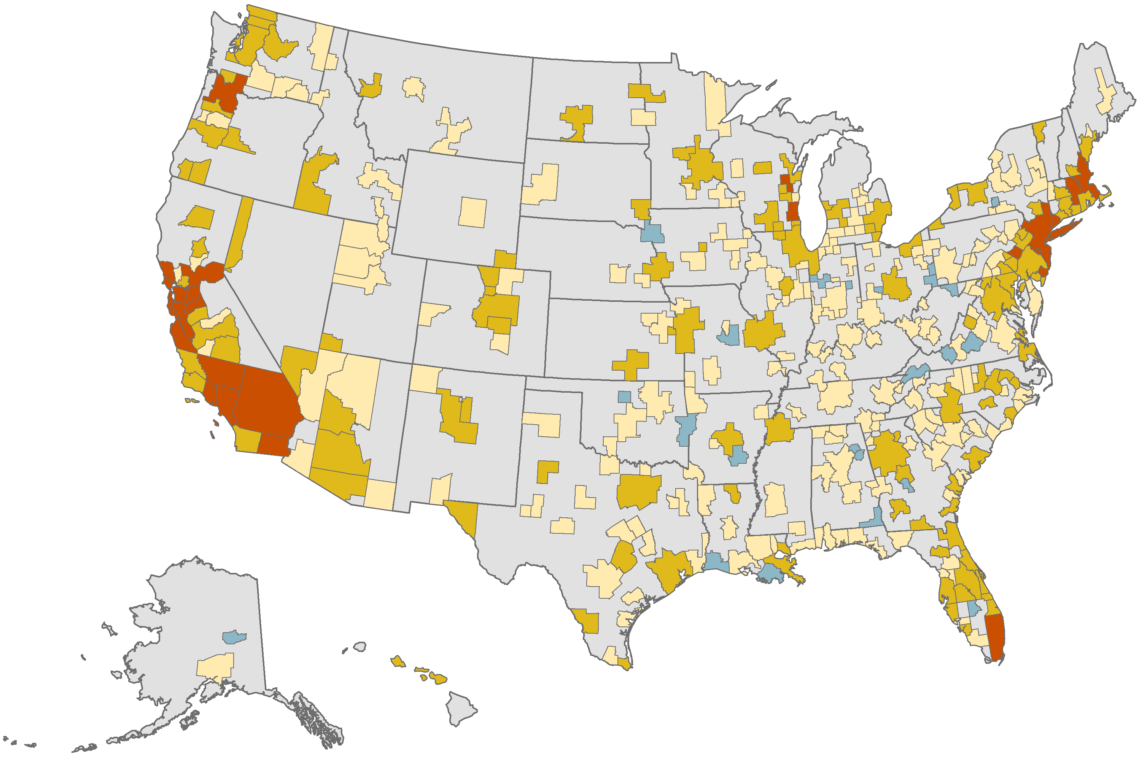
In Many Metros More than One Third of Older Households Face Cost Burdens
Share of Older Adult Households
With Cost Burdens (Percent)
Under 20
20–29
30–39
40 and Over
Notes: Data are for households headed by a person age 65 and over. Cost-burdened households pay more than 30 percent of income for housing. Households with zero or negative income are assumed to have cost burdens, while households paying no cash rent are assumed to be without burdens.
Source: JCHS tabulations of US Census Bureau, 2017 American Community Survey 1-Year Estimates and Missouri Census Data Center data.

Slide 10
The Numbers of Older Households with Very Low Incomes Are Expected to Climb Sharply as the US Population Ages
Older Households with Incomes Under 50 Percent of Area Median (Millions)
Notes: Very low income (VLI) households earn under 50 percent of area median income. VLI as a share of all households is constant. Assisted and unassisted households are age 62 and over, while projected households are age 60 and over.
Source: JCHS tabulations of Worst Case Housing Needs 2007-2017 Reports to Congress; US Census Bureau, Current Population Surveys 2015-2018 3-year trailing average; and Joint Center Household Projections.

