Slide 1
State of the Nation’s Housing 2020 Figures
November 19, 2020

Slide 2
Chapter 1. Executive Summary

Slide 3
Figure 1: Heading Into the Pandemic, Renter Cost Burden Rates Were Already High and Moving Up the Income Scale
Notes: Incomes are adjusted for inflation using the CPI-U for All Items. Moderately (severely) cost-burdened households pay 31–49% (50% or more) of income for housing. Households with zero or negative income are assumed to have severe burdens, while households paying no cash rent are assumed to be without burdens.
Source: JCHS tabulations of US Census Bureau, American Community Survey 1-Year Estimates.

Slide 4
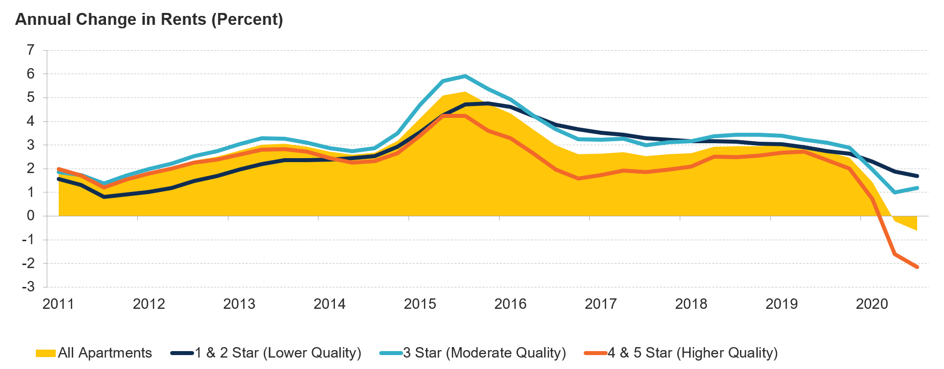
Figure 2: Rent Growth Has Slowed Sharply, Particularly at Higher-Quality Properties
Note: Apartment quality is based on the CoStar Building Rating System for professionally managed market-rate apartments in buildings with five or more units. Source: JCHS tabulations of CoStar data.

Slide 5
Figure 3: Across Income Groups, Homeowners of Color Are More Likely than White Homeowners to Have Fallen Behind on Housing Payments During the Pandemic
Notes: Homeowners behind on housing payments reported that they were not caught up at the time of survey. White, Black, and Asian households are non-Hispanic. Hispanic households may be of any race. Totals include owners that identify as other races or as multiracial.
Source: JCHS tabulations of US Census Bureau, Household Pulse Survey, Week 15.

Slide 6
Figure 4: Home Sales Surged After a Sharp Dive in the Spring
Year-over-Year Change (Percent)
Notes: Year-over-year changes are based on seasonally adjusted data, while the year-to-date changes are not seasonally adjusted. Recent monthly data are subject to revision.
Source: JCHS tabulations of US Census Bureau, New Residential Sales; National Association of Realtors (NAR), Existing Home Sales.

Slide 7
Figure 5: People of Color Are More Concentrated in High-Poverty Areas than White People with Similar Incomes
Notes: Incomes above or below the poverty line are defined by the official measure of poverty established by the Office of Management and Budget (OMB). Only white individuals are non-Hispanic. Since Hispanic individuals may be of any race, there is some overlap with other racial categories.
Source: JCHS tabulations of US Census Bureau, 2018 American Community Survey 5-Year Estimates.

Slide 8
Figure 6: The Number of Cost-Burdened Renters Has Grown as Housing Assistance Has Become a Lower Budget Priority
Notes: Cost-burdened households pay more than 30% of income for housing. Households with zero or negative income are assumed to have burdens, while households paying no cash rent are assumed to be without burdens.
Source: JCHS tabulations of US Census Bureau, American Community Survey 1-Year Estimates; US Office of Management and Budget, Historical Tables, Budget of the United States Government, Fiscal Year 2021, Table 8.7, Outlays for Discretionary Programs: 1962–2025.

Slide 9
Chapter 2. Housing Markets

Slide 10
Figure 7: After a Steady Decline in Early 2020, New Home Sales Are Now Well Above Year-Earlier Levels
Annualized New Home Sales (Thousands of units, seasonally adjusted)
Note: Recent monthly data are subject to revision.
Source: JCHS tabulations of US Census Bureau, New Residential Sales.

Slide 11
Figure 8: Housing Construction Is Back on Track After a Near-Record Decline in the Spring
Annualized Housing Starts (Thousands of units, seasonally adjusted)
Notes: Single-family and multifamily historical averages are of seasonally adjusted monthly data from January 1990 to September 2020. Recent monthly data are subject to revision.
Source: JCHS tabulations of US Census Bureau, New Residential Construction data.

Slide 12
Figure 9: Multifamily Construction Has Driven a Building Boom in Core Counties
Average Multifamily Permits (Thousands)
County Location
Notes: Large metro areas have at least 1 million residents. Core counties contain either the largest city in the metro area or any city with over 250,00 residents. Non-core counties are all other counties in large metro areas.
Source: JCHS tabulations of US Census Bureau, Building Permits Survey via Moody’s Economy.com.

Slide 13
Figure 10: Although Reviving Across Locations, Single-Family Construction Still Lags Historical Averages
Average Single-Family Permits (Thousands)
County Location
Notes: Large metro areas have at least 1 million residents. Core counties contain either the largest city in the metro area or any city with over 250,00 residents. Non-core counties are all other counties in large metro areas.
Source: JCHS tabulations of US Census Bureau, Building Permits Survey via Moody’s Economy.com.

Slide 14
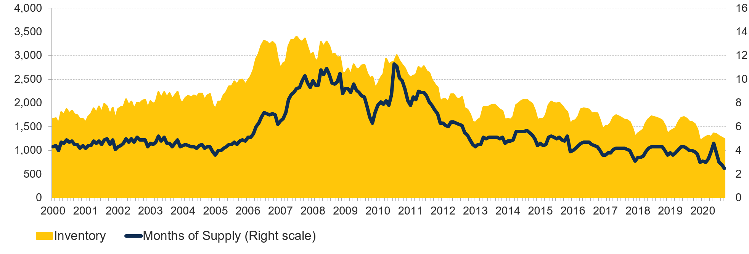
Figure 11: Already Near Historic Lows, the Supply of Homes for Sale Declined Again in 2020
Homes for Sale (Thousands)
Months of Supply
Notes: Data are for single-family homes only. Months of supply measure how long it would take the number of homes on the market to sell at the current rate, where six months is typically considered a balanced market.
Source: JCHS tabulations of NAR, Existing Home Sales.

Slide 15
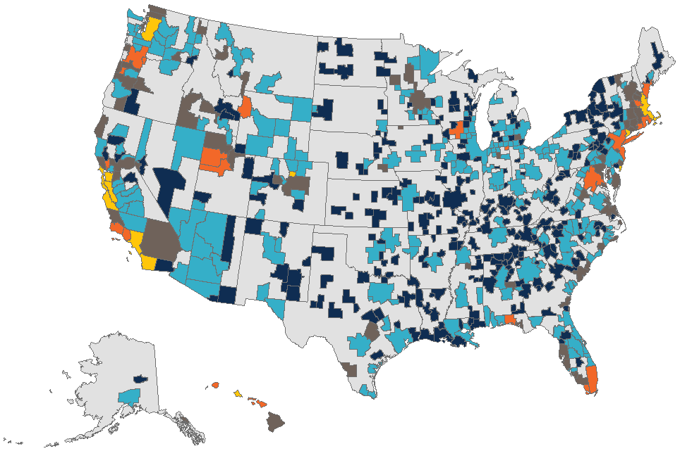
Figure 12: Land Costs Account for More Than Half of Single-Family Property Values in Several Highly Restricted Housing Markets
Median Land Value as Share of Property Value
Under 20%
20–29%
30–39%
40–49%
50% and Over
Note: Prices are for land occupied by existing single-family homes.
Source: JCHS tabulations of Federal Housing Finance Agency (FHFA), The Price of Residential Land for Counties, ZIP Codes, and Census Tracts in the United States.

Slide 16
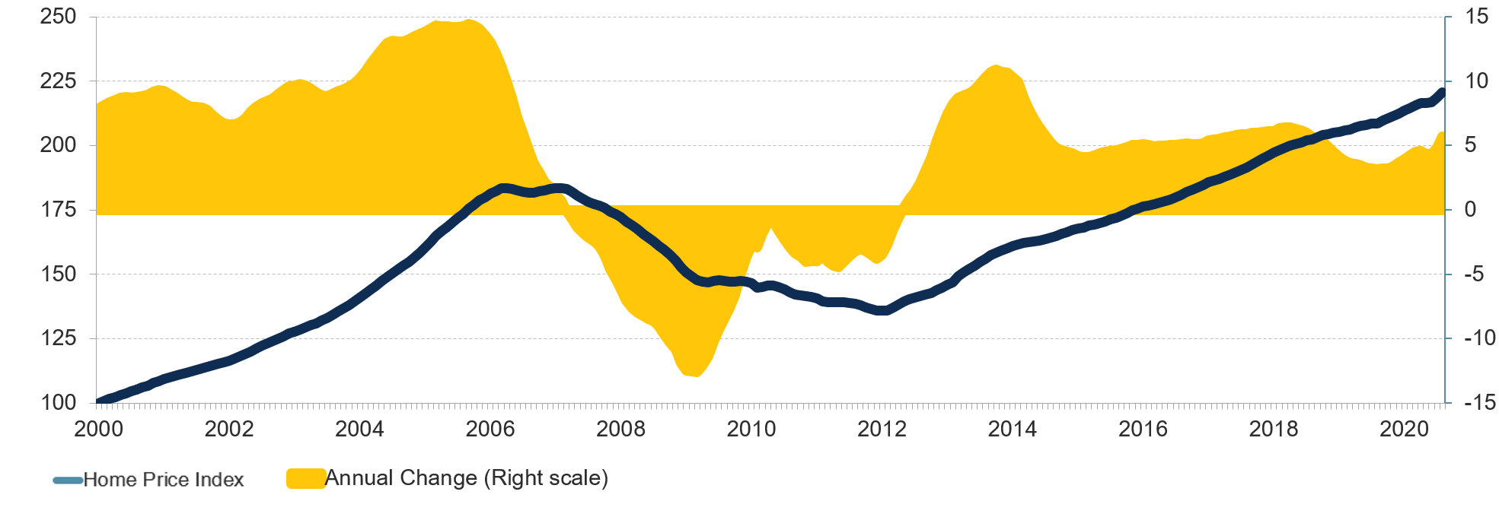
Figure 13. Home Prices Continued to Climb Through the Summer Months
Home Price Index
Annual Change (Percent)
Source: JCHS tabulations of S&P CoreLogic Case-Shiller US National Home SA Price Index.

Slide 17
Chapter 3. Demographic Drivers

Slide 18
Figure 14: The Latest Surveys Point to a Continuing Pickup in Household Growth in Early 2020
Average Annual Household Growth (Millions)
Note: Estimate for 2020:1 is based on year-over-year change in the four-quarter trailing average.
Source: JCHS tabulations of US Census Bureau, American Community Survey 1-Year Estimates via IPUMS USA, University of Minnesota, www.ipums.org.

Slide 19
Figure 15: Census Estimates Indicate that Population Growth Has Slowed Far Earlier than Projected
Source: JCHS tabulations of US Census Bureau, 2019 vintage Population Estimates and 2017 Middle-Series Population Projections.

Slide 20
Figure 16: While Still Concentrated in Suburban Communities, Household Growth Made a Comeback in Cities
Notes: Cities are defined following Kneebone & Nadeau (2015), where city tracts are either in the metro’s principal city or in cities with populations over 100,000. All non-city tracts in metro areas are suburban.
Source: JCHS tabulations of US Census Bureau, 1990 and 2000 Decennial Censuses and 2010, 2014, and 2018 American Community Survey 5-Year Estimates.

Slide 21
Figure 17: Declining Unemployment and Rising Incomes Set the Stage for a Strong Housing Market in 2020
Unemployment Rate (Percent) Median Income (2019 Dollars)
Note: Incomes are adjusted for inflation using the CPI-U for All Items.
Source: JCHS tabulations of US Census Bureau, American Community Survey 1-Year Estimates via IPUMS USA, and Current Population Surveys via IPUMS CPS, University of Minnesota, www.ipums.org.

Slide 22
Figure 18: The Black-White Income Gap Widened Further in the 2010s
Median Income (2019 Dollars) Gap (2019 Dollars)
Note: Incomes are adjusted for inflation using the CPI-U for All Items.
Source: JCHS tabulations of US Census Bureau, 1980, 1990, and 2000 Decennial Censuses, and 2010 and 2019 American Community Survey 1-Year Estimates via IPUMS USA, University of Minnesota, www.ipums.org.

Slide 23
Figure 19: US Households Are Becoming Older and More Diverse
Change in Households, 2014–2019 (Millions) Share of Households (Percent)
Notes: Householders who are white, Black, Asian, or another race are non-Hispanic. Hispanic householders may be of any race.
Source: JCHS tabulations of US Census Bureau, American Community Survey 1-Year Estimates.

Slide 24
Chapter 4. Homeownership

Slide 25
Figure 20: Growth in Homeowner Households Revived After 2016, Lifting the Homeownership Rate
Homeowner Households (Millions)
Homeownership Rate (Percent)
Source: JCHS tabulations of US Census Bureau, Housing Vacancy Surveys.

Slide 26
Figure 21: Home Equity Has Reached a Record High While Mortgage Debt Remains More Moderate
Note: Homeowner equity and mortgage debt are adjusted for inflation using the CPI-U for All Items.
Source: JCHS tabulations of Federal Reserve Board, Financial Accounts of the United States via FRED.

Slide 27
Figure 22: After a Sharp But Brief Drop, Home Loan Applications Rebounded Quickly by June
Year-over-Year Change in Home Purchase Mortgage Applications (Percent)
Note: Monthly data are weekly averages.
Source: JCHS tabulations of Mortgage Bankers Association (MBA), Weekly Applications Survey via Moody’s Economy.com.

Slide 28
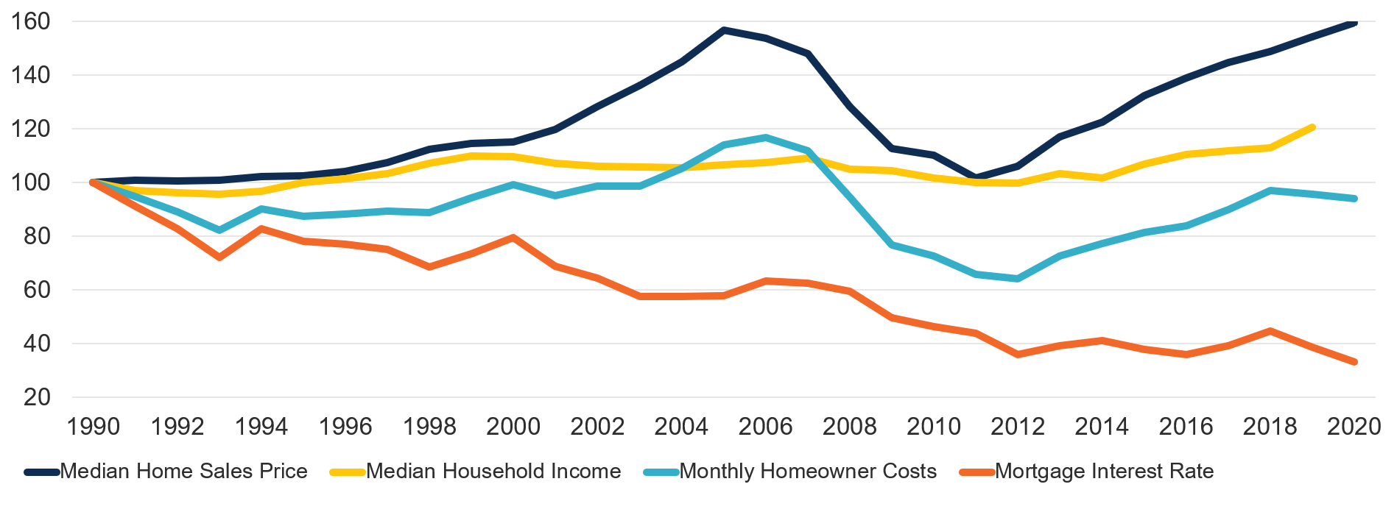
Figure 23: Higher Incomes and Lower Interest Rates Have Offset the Rise in House Prices, Bringing Down the Real Cost of Homeownership
Index
Notes: House prices and monthly homeowner costs are adjusted to 2020 dollars using the CPI-U for All Items less shelter. Household incomes are adjusted to 2019 dollars using the CPI-U-RS for All Items. Monthly homeowner costs assume a 3.5% downpayment on a median-priced, existing single-family home (including condos and coops) with property taxes of 1.15%, property insurance of 0.35%, and mortgage insurance of 0.85%. Data for 2020 are the monthly averages from January to June.
Source: JCHS tabulations of NAR, Existing Home Sales; US Census Bureau, Current Population Surveys; Moody’s Analytics Forecasts; Freddie Mac, Primary Mortgage Market Surveys.

Slide 29
Figure 24: Black Households Experience Especially High Denial Rates for Mortgages
Mortgage Denial Rate (Percent)
Notes: White households are non-Hispanic. Hispanic households are white only. Asian and Black households may be either Hispanic or non-Hispanic.
Source: JCHS tabulations of 2019 Home Mortgage Disclosure Act data.

Slide 30
Figure 25: Homeownership Gaps Persist Across All Age Groups, with the Largest Disparities Between Black and White Households
Notes: White, Asian, and Black householders are non-Hispanic. Hispanic householders may be of any race.
Source: JCHS tabulations of US Census Bureau, Current Population Surveys via IPUMS CPS, University of Minnesota, www.ipums.org.

Slide 31
Chapter 5. Rental Housing

Slide 32
Figure 26: Many Tenants with Lower Incomes and in Small Rental Buildings Have Had Difficulty Keeping Up with Rent
Note: Households behind on rent reported that they were not caught up at the time of survey.
Source: JCHS tabulations of US Census Bureau, Household Pulse Survey, Week 15.

Slide 33
Figure 27: Growth in Rental Demand Was Flat Even Before the Pandemic Hit
Rentership Rate (Percent)
Note: Estimates for 2020:1 are based on year-over-year change in the four-quarter trailing average. Source: JCHS tabulations of US Census Bureau, Housing Vacancy Surveys.

Slide 34
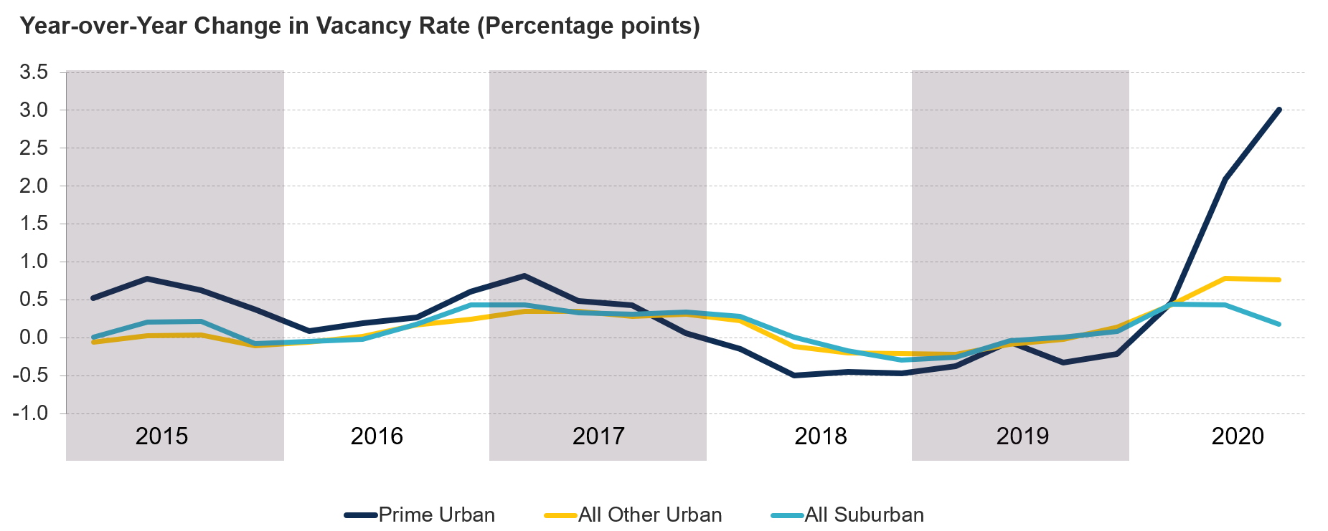
Figure 28: Vacancies Have Climbed Sharply in Prime Urban Areas
Neighborhood Type
Notes: Prime urban areas are the most expensive urban markets. Urban/suburban areas are defined based on density in the 54 largest markets that CoStar tracks. Source: JCHS tabulations of CoStar data.

Slide 35
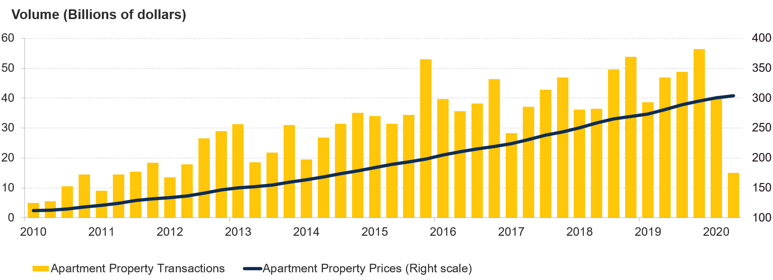
Figure 29: Sales of Apartment Properties Plunged in Early 2020, But Prices Continued Their Ascent
Property Prices (Indexed)
Note: Apartment property prices are nominal and indexed to 2000.
Source: JCHS tabulations of Real Capital Analytics data.

Slide 36
Figure 30: The Rental Stock Has Shifted Toward Single-Family Homes and Large Multifamily Buildings, Where Rents Have Risen the Most
Notes: Rental units may be occupied, vacant for rent, or rented but unoccupied. Median rents are adjusted for inflation using the CPI-U for All Items Less Shelter. Median rents are for occupied units only and exclude units occupied without payment of rent.
Source: JCHS tabulations of US Census Bureau, American Community Survey 1-Year Estimates.

Slide 37
Figure 31: The Geographic Concentration of Rental Housing Contributes to Economic and Racial Segregation
Neighborhood Type
Neighborhood Type
Notes: Neighborhoods are census tracts. The housing stock in high-rental neighborhoods is more than 80 percent rental, while the stock in high-ownership neighborhoods is more than 80 percent owner-occupied or vacant for sale. Estimates are neighborhood averages.
Source: JCHS tabulations of US Census Bureau, 2018 American Community Survey 5-Year Estimates.

Slide 38
Chapter 6. Housing Challenges

Slide 39
Figure 32: Despite Recent Progress, the Number of Cost-Burdened Households Still Exceeds 37 Million
Notes: Cost-burdened households pay more than 30% of income for housing. Households with zero or negative income are assumed to have burdens, while households paying no cash rent are assumed to be without burdens.
Source: JCHS tabulations of US Census Bureau, American Community Survey 1-Year Estimates.

Slide 40
Figure 33: Households of Color Are More Likely to Have Fallen Behind on Housing Payments
Notes: Households behind on rent or mortgage reported that they were not caught up at the time of survey. White, Black, and Asian households are non-Hispanic. Hispanic households may be of any race. Total includes households that identify as another race or as multiracial.
Source: JCHS tabulations of US Census Bureau, Household Pulse Survey, Week 15.

Slide 41
Figure 34: The Burden of High Housing Costs Prevents Vulnerable Households from Meeting Other Basic Needs
Households with Children Under Age 18
Households Headed by Adults Age 65 and Over
Notes: Data are for households in the bottom quartile of expenditures. Households are moderately (severely) burdened if housing accounts for more than 30% (more than 50%) of their spending. Healthcare expenditures include out-of-pocket costs and insurance premiums.
Source: JCHS tabulations of Bureau of Labor Statistics, 2018 Consumer Expenditure Survey.

Slide 42
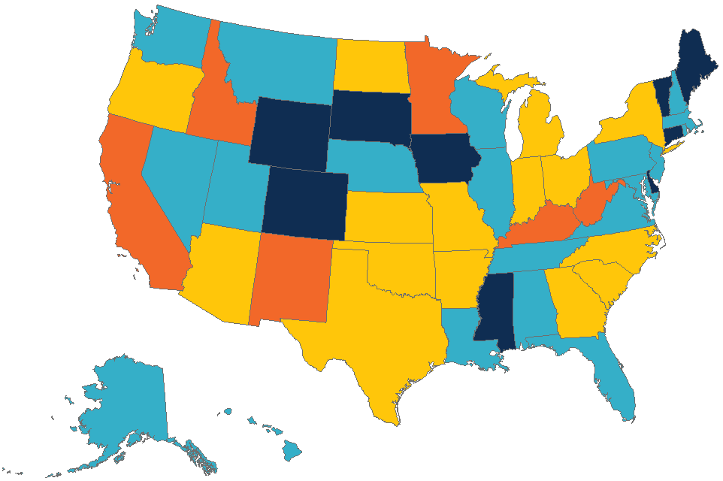
Figure 35: Homelessness Increased in Both High- and Low-Cost Housing Markets in 2019
Change in Homelessness,
2018–2019
More than 10% Decline (Up to 24%)
0–10% Decline
0–10% Increase
More than 10% Increase (Up to 27%)
Source: JCHS tabulations of US Department of Housing and Urban Development (HUD), 2019 Annual Homeless Assessment Report Point-in-Time Estimates.

Slide 43
Figure 36: People of Color with Low Incomes Are Concentrated in High-Poverty Neighborhoods
Race/Ethnicity
Notes: Incomes above or below the poverty line are defined by the official measure of poverty established by the OMB. Only white individuals are non-Hispanic. Since Hispanic individuals may be of any race, there is some overlap with other racial categories.
Source: JCHS tabulations of US Census Bureau, 2018 American Community Survey 5-Year Estimates.

Slide 44
Figure 37: Many Households of Color Live in Overcrowded Conditions
Notes: Asian, American Indian/Alaska Native, white, and Black householders are non-Hispanic. Hispanic householders may be of any race.
Source: JCHS tabulations of US Census Bureau, 2019 American Community Survey 1-Year Estimates.

