Slide 1
State of the Nation’s Housing 2019
Figures and figure data are compiled here for reference. Some data are not available in accordance with JCHS data agreements with external data providers. To use or publish figures or figure data, please contact the Joint Center for Housing Studies at jchs@harvard.edu.

Slide 2
Chapter 1. Executive Summary

Slide 3
Figure 1. Housing Construction Has Just Kept Pace with Household Growth for an Unprecedented Eight Years
Units (Millions)
Notes: Household growth data are three-year trailing averages. Placements refers to newly built mobile homes placed for residential use.
Source: JCHS tabulations of US Census Bureau Housing Vacancy Survey, New Residential Construction data.

Slide 4
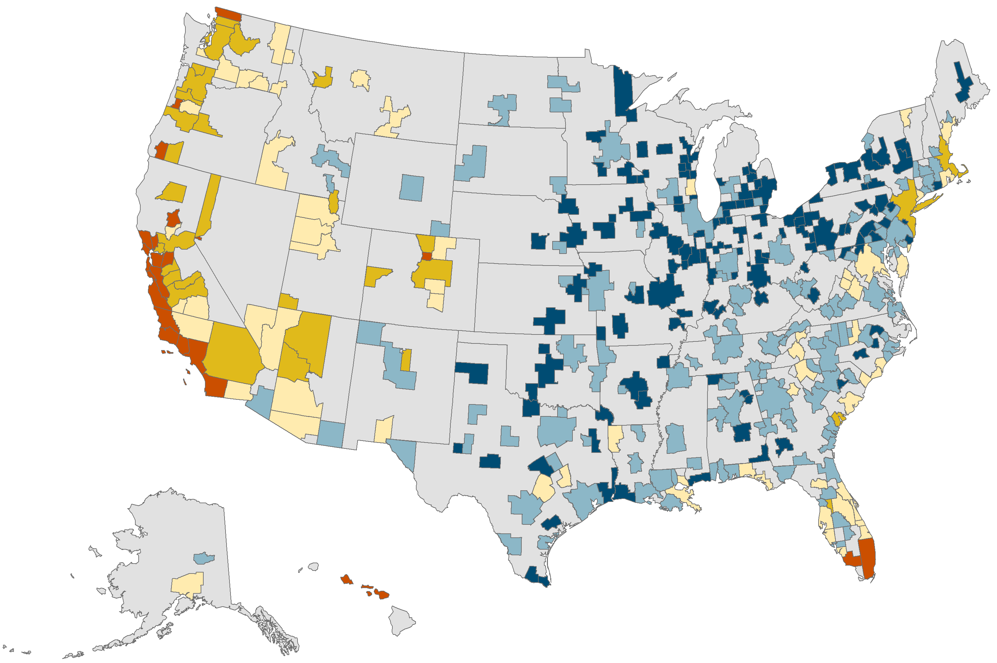
Figure 2. Although Homebuying Is Still Affordable in Many Markets, Price-to-Income Ratios Are Back Near Peak Levels
Note: Home prices are the median prices of existing homes sold in the metro area in 2018. Incomes are the median household incomes for each metro.
Source: JCHS tabulations of National Association of Realtors (NAR), Metropolitan Median Area Prices; Moody’s Analytics Estimates.

Slide 5
Figure 3. The Low-Rent Stock Has Shrunk by Four Million Units Since 2011
Units (Millions)
Percent
Note: Contract rents are inflated using CPI-U for All Items Less Shelter.
Source: JCHS tabulations of US Census Bureau, American Community Survey 1-Year Estimates.

Slide 6
Figure 4. Although Improving Nationally, Renter Cost-Burden Rates Are Still Rising Across Most Income Groups
Share of Renter Households with Cost Burdens (Percent)
Notes: Household incomes are adjusted to 2017 dollars using the CPI-U for All Items. Moderately (severely) cost-burdened households pay more than 30% (more than 50%) of income for housing. Households with zero or negative income are assumed to have severe burdens, while households paying no cash rent are assumed to be without burdens.
Source: JCHS tabulations of US Census Bureau, American Community Survey 1-Year Estimates.

Slide 7
Figure 5. Over the Next Decade, the Millennial and Baby-Boomer Generations Will Swell the Populations in Key Age Groups
US Population (Millions)
Source: JCHS tabulations of US Census Bureau, 2017 National Population Projections.

Slide 8
Chapter 2. Housing Markets

Slide 9
Figure 6. Although Slowing at the End of 2018, Housing Construction Was Up for the Year
Housing Starts (Millions of units)
Note: Data are based on 12-month trailing averages.
Source: JCHS tabulations of US Census Bureau, New Residential Construction data.

Slide 10
Figure 7. Single-Family Construction in the Midwest and Northeast Remains Particularly Weak
Single-Family Starts (Thousands)
Multifamily Starts (Thousands)
Source: JCHS tabulations of US Census Bureau, New Residential Construction.

Slide 11
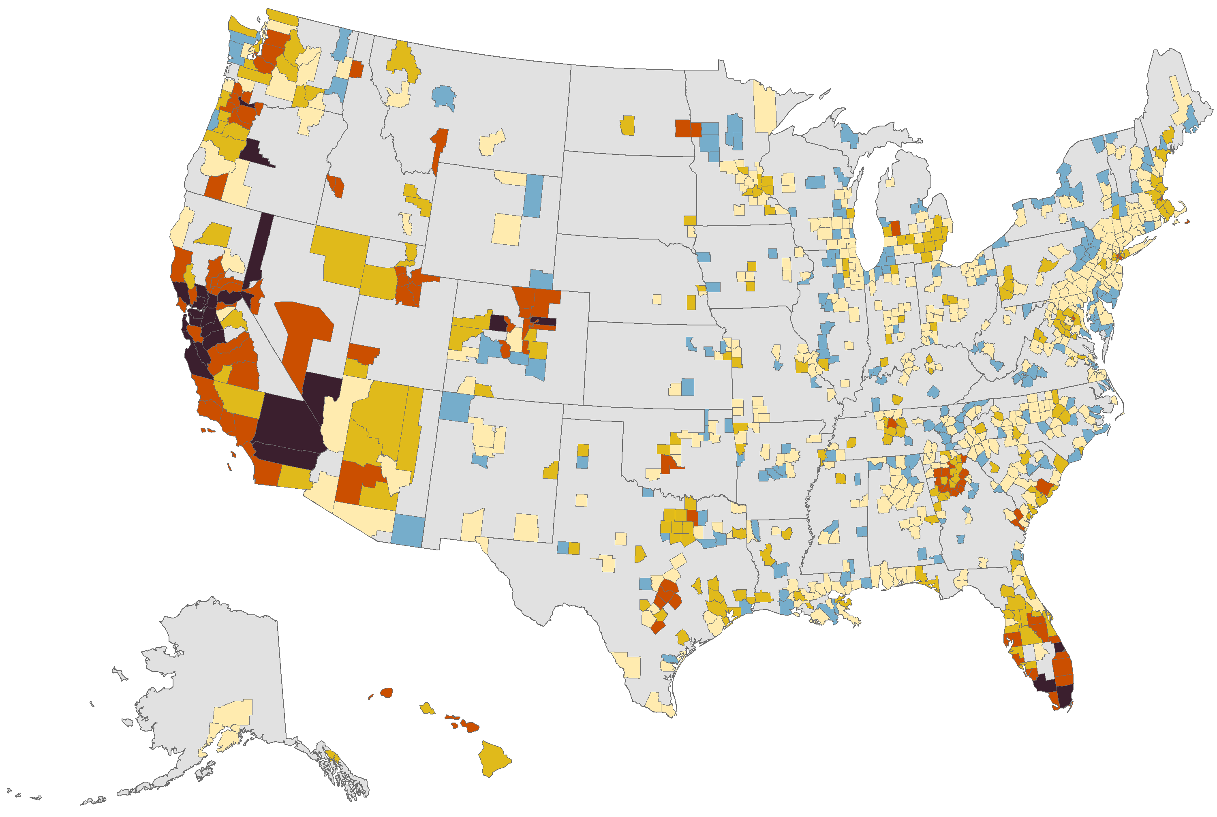
Figure 8. Residential Land Prices in Many Areas Have Risen Sharply Since 2012
Change in Median Land Value, 2012–2017 (Percent)
Decline
0–24
25–49
50–99
100 and Over
Note: Estimates are for land underneath existing single-family homes.
Source: JCHS tabulations of FHFA, The Price of Residential Land for Counties, ZIP codes, and Census Tracts in the United States.

Slide 12
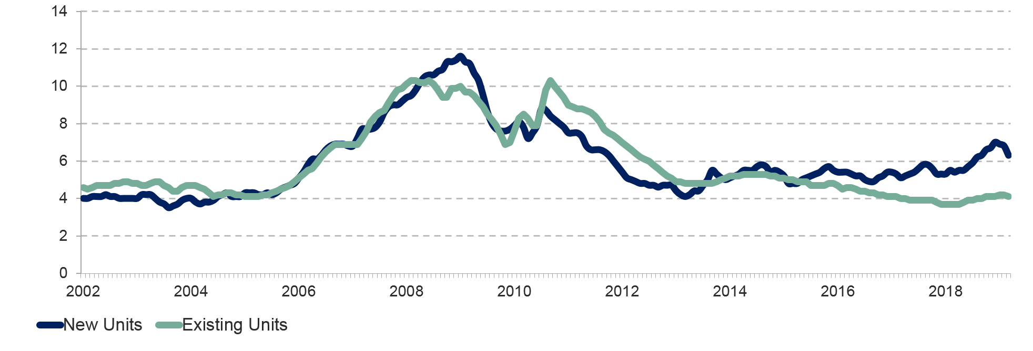
Figure 9. Inventories of Both New and Existing Homes for Sale Remain Tight Despite Recent Increases
Months of Supply
Notes: Data are three-month trailing averages and for single-family homes only. Months of supply measures how long it would take the number of homes on the market to sell at the current rate, where six months is typically considered a balanced market.
Source: JCHS tabulations of National Association of Realtors (NAR), Existing Home Sales and US Census Bureau, New Residential Sales.

Slide 13
Figure 10. After Trending Up for Six Years, Home Price Appreciation Began to Slow Across Market Types in Late 2018
Year-over-Year Change in Home Prices (Percent)
Notes: Non-metro prices are weighted averages of all state non-metro prices, with each state's value weighted by the share of detached single-family housing units in non-metro areas. Highest- (lowest-) cost metros are the 10 metros among the top 100 with the highest (lowest) median home values in 2018 from Zillow.
Source: JCHS tabulations of FHFA, All-Transactions House Price Index.

Slide 14
Figure 11. In Many Large Metro Areas, Home Price-to-Income Ratios Are Approaching Mid-2000s Levels
Number of Metro Areas
US Ratio
Price-to-Income Ratio
Note: Data are for the 100 largest metro areas by population.
Source: JCHS tabulations of NAR, Metropolitan Median Area Prices and Moody’s Analytics Estimates.

Slide 15
Chapter 3. Demographic Drivers

Slide 16
Figure 12. Household Growth Has Stabilized at Early 2000s Levels
Household Growth (Millions)
Note: Data are three-year trailing averages.
Source: JCHS tabulations of US Census Bureau, Housing Vacancy Survey; JCHS 2018 Household Projections.

Slide 17
Figure 13. The Number of Young-Adult Households Is Finally Rising in Line with Population Growth
Population (Millions) Households (Millions)
Note: Data are 3-year trailing averages.
Source: JCHS tabulations of US Census Bureau, Housing Vacancy Surveys and National Population Estimates.

Slide 18
Figure 14. High Rents Delay the Ability of Younger Adults to Form Independent Households
Average Household Headship Rates (Percent)
Note: Data are for the 100 metros with the largest populations in 2017. Highest- and lowest-rent metros are ranked by metro area median rent.
Source: JCHS tabulations of US Census Bureau, 2017 American Community Survey 1-Year Estimates and Missouri Census Data Center.

Slide 19
Figure 15. Income Growth Among Younger Adults Has Been Particularly Strong
Age Group
Note: Incomes are three-year rolling averages, adjusted for inflation using the CPI-U for All Items.
Source: JCHS tabulations of US Census Bureau, Current Population Surveys via IPUMS CPS.

Slide 20
Figure 16. Recent Immigrants Are Better Educated than Their Predecessors…
Share of Recent Immigrants by Educational Attainment (Percent)
Notes: Educational attainment data include only foreign born adults age 25 and over. Birthplace data include recent immigrants of all ages. Recent immigrants in 1990 and 2000 are those who entered the country in the last 5 years. Recent immigrants in 2010 and 2017 immigrated in the past year.
Source: JCHS tabulations of US Census Bureau, Decennial Censuses and American Community Survey 1-Year Estimates via IPUMS USA.

Slide 21
Figure 17. …and Originated from a Different Mix of Countries
Share of Recent Immigrants by Birthplace (Percent)
Notes: Birthplace data include recent immigrants of all ages. Recent immigrants in 1990 are those who entered the country in the last 5 years. Recent immigrants in 2017 immigrated in the past year. Other birthplaces include Australia, New Zealand, Canada, Atlantic and Pacific Island countries, Puerto Rico, and other US territories.
Source: JCHS tabulations of US Census Bureau, 1990 Decennial Census and 2017 American Community Survey 1-Year Estimates via IPUMS USA.

Slide 22
Figure 18. Over the Next Decade, the Fastest-Growing Household Types Will Be Younger Families with Children and Older Single Persons and Empty-Nesters
Projected Change in Households, 2018–2028 (Millions)
Source: JCHS 2018 Household Projections.

Slide 23
Chapter 4. Homeownership

Slide 24
Figure 19. Homeownership Has Gained Some Upward Momentum
Households (Millions)
Percent
Note: Change in owner households is year-over-year.
Source: JCHS tabulations of US Census Bureau, Housing Vacancy Surveys.

Slide 25
Figure 20. First-Time Homebuyers are Younger and More Diverse than Current Homeowners
Share of Homeowners (Percent)
Age
Race/Ethnicity
Household Type
Notes: Homebuyers purchased homes in 2016 and early 2017. First-time homebuyers never previously owned a home. Black, Asian/other, and White are non-Hispanic. Other household types include all other family and non-family households.
Source: HUD, 2017 American Housing Survey.

Slide 26
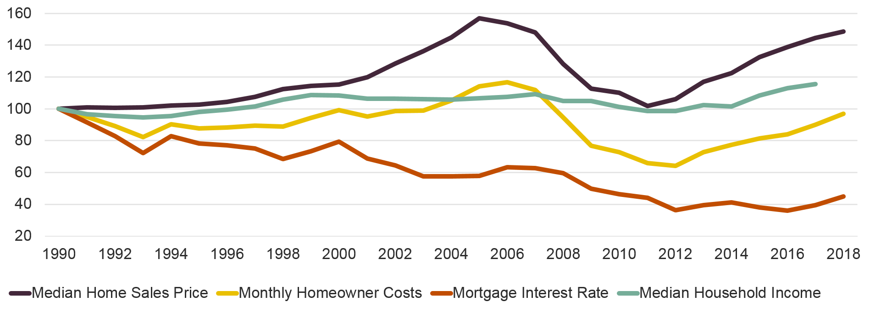
Figure 21. With Low Interest Rates Offsetting the Rise in Home Prices, Real Homeowner Costs Are Still Lower than in 1990
Index
Notes: House prices, household income, and monthly homeowner costs are adjusted to 2018 dollars using the CPI-U for all items less shelter. Monthly homeowner costs assume a 3.5% downpayment on a median-priced, existing single-family home (including condos and coops) with property taxes of 1.15%, property insurance of 0.35%, and mortgage insurance of 0.85%.
Source: JCHS tabulations of NAR, Existing Home Sales; US Census Bureau, Current Population Surveys; Moody’s Analytics Forecasts; Freddie Mac, Primary Mortgage Survey (PMMS).

Slide 27
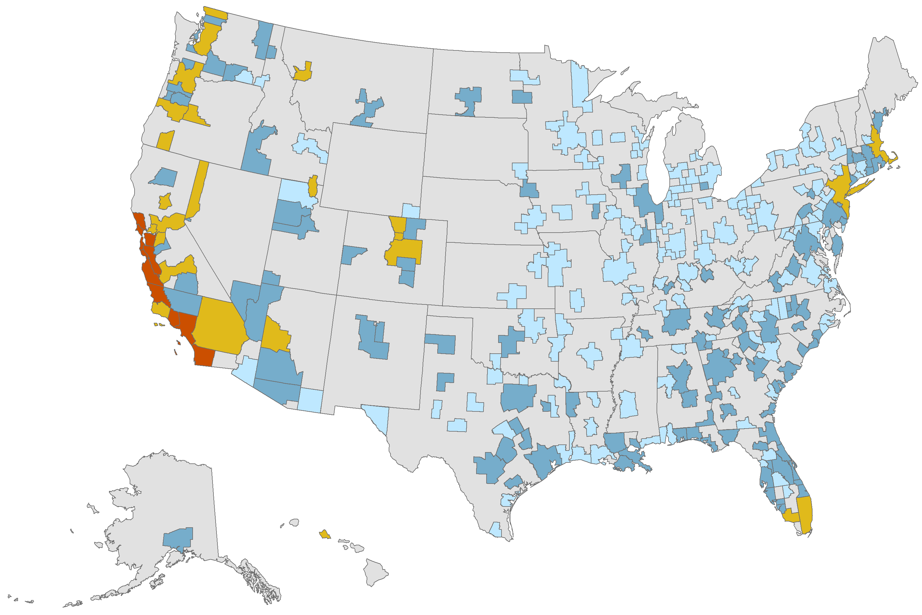
Figure 22. Affordability of Homeownership for Potential Buyers Varies Widely Across the Country
Share of Recently Sold Homes Affordable to Median-Income Households (Percent)
0–24
25–49
50–74
75–100
Notes: Median incomes are estimated at the core-based statistical area (CBSA) level. Recently sold homes are defined as homes with owners that moved within the 12 months prior to the survey date. Monthly payments assume a 3.5% downpayment and property taxes of 1.15%, property insurance of 0.35%, and mortgage insurance of 0.85%. Affordable payments are defined as requiring less than 31% of monthly household income. Only CBSAs with at least 30 home sales in the past year are shown.
Source: JCHS tabulations of US Census Bureau, 2017 American Community Survey 1-Year Estimates, and Freddie Mac, PMMS.

Slide 28
Figure 23. Home Purchase Loans Continue to Increase Incrementally, While Refinancings Vary with Interest Rates
Number of Mortgage Originations (Millions) Interest Rate (Percent)
Note: Originations are first-lien, 1-4 family, owner-occupied mortgage loans for home purchase or refinancing.
Source: JCHS tabulations of Home Mortgage Disclosure Act (HMDA) data; Freddie Mac Primary Mortgage Market Survey for 30-year Fixed-Rate Mortgages.

Slide 29
Figure 24. Home Equity Is Nearing Its Pre-Crisis Peak, Driven by Rising Home Prices
Note: Homeowner equity and mortgage debt are adjusted to 2018 dollars using the CPI-U for all items.
Source: JCHS tabulations of Federal Reserve Board Financial Accounts of the United States via FRED.

Slide 30
Chapter 5. Rental Housing

Slide 31
Figure 25. The Number and Share of Renter Households Continued to Decline in 2018
Households (Millions)
Share of All Households (Percent)
Source: JCHS tabulations of US Census Bureau, Housing Vacancy Surveys.

Slide 32
Figure 26. Growth in Higher-Income Renters Has Helped Sustain Rental Demand
Notes: Income categories inflated using CPI-U for All items.
Source: JCHS tabulations of US Census Bureau, Current Population Surveys via IPUMS CPS.

Slide 33
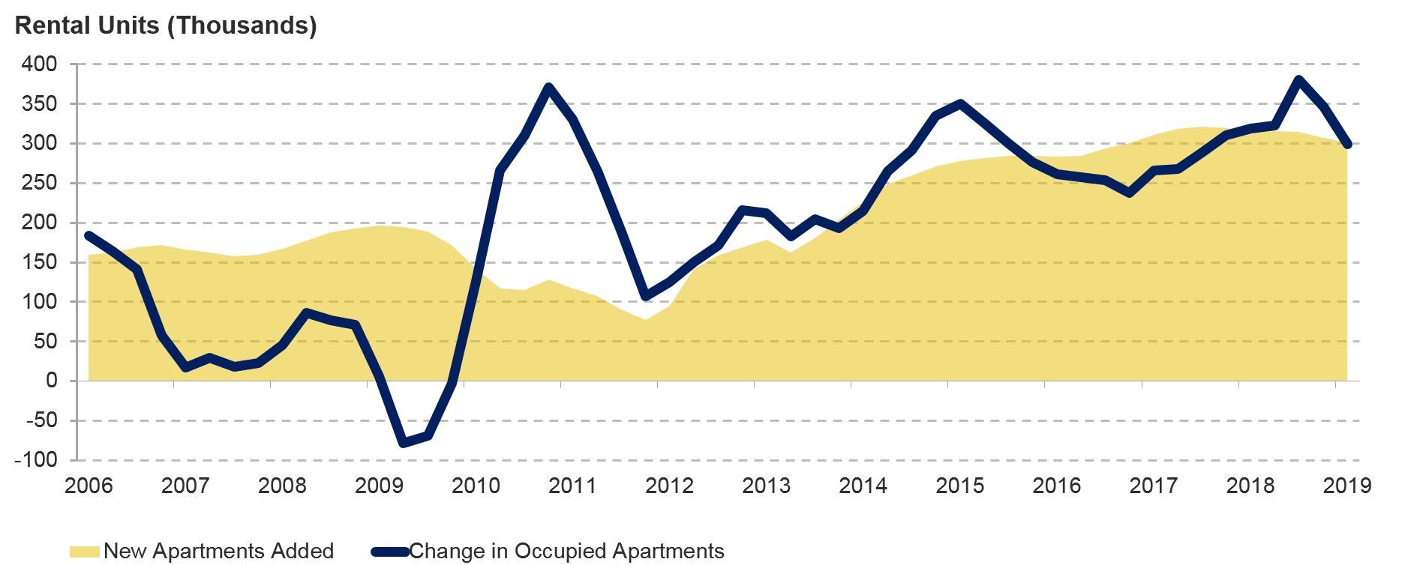
Figure 27. Apartment Demand Continues to Grow in Line with Additions to Supply
Note: Net change in occupied apartment units, also called net unit absorptions, is the change in physically occupied units from one period to another.
Source: RealPage data.

Slide 34
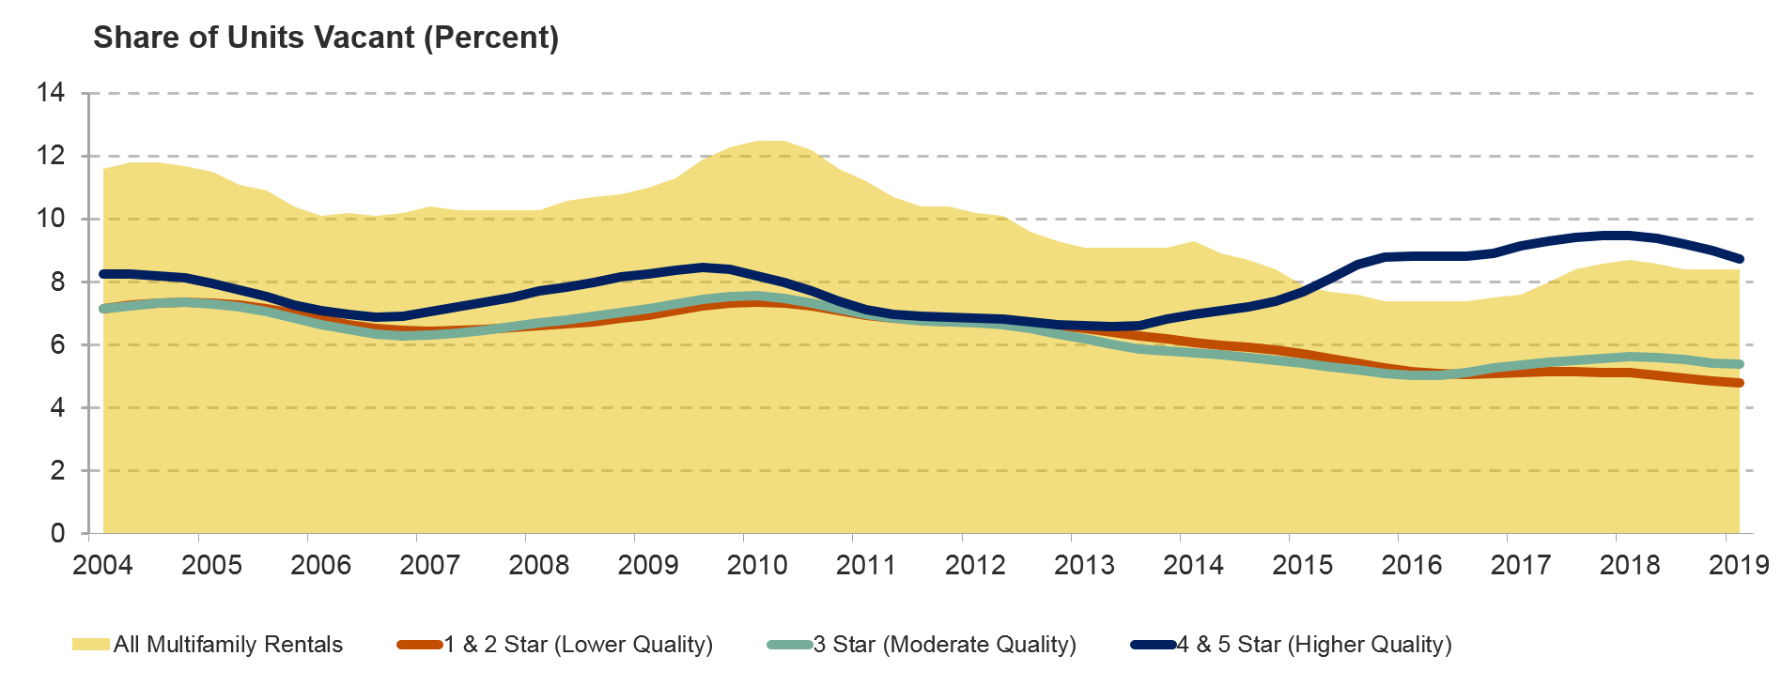
Figure 28. Rental Vacancy Rates Fell Across the Board in 2018
Notes: Lower/Moderate/Higher-quality apartments are defined as 1&2 / 3 / 4&5 star apartments according to the CoStar Building Rating System, which is a nationally consistent rating of building quality across markets. Vacancy rates are calculated as smoothed 4-quarter trailing average. Vacancy rate for all multifamily rental units is for units in buildings with at least 5 units from the HVS. CoStar data cover market-rate apartments in buildings with five or more units.
Source: JCHS tabulations US Census Bureau, Housing Vacancy Surveys, and CoStar data.

Slide 35
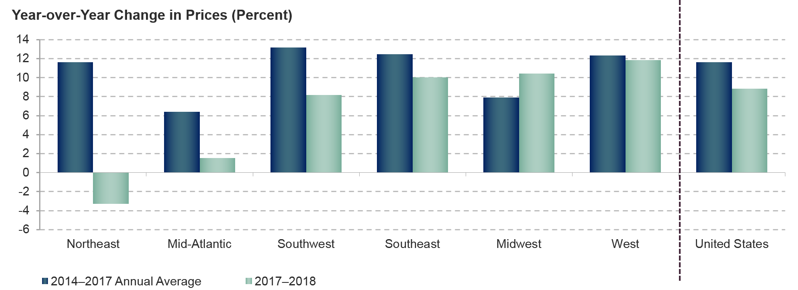
Figure 29. Despite Some Slowdown Last Year, Apartment Property Prices Continue to Climb in Most Regions
Notes: Price growth is calculated as year-over-year growth in the fourth quarter.
Source: JCHS tabulations of Real Capital Analytics.

Slide 36
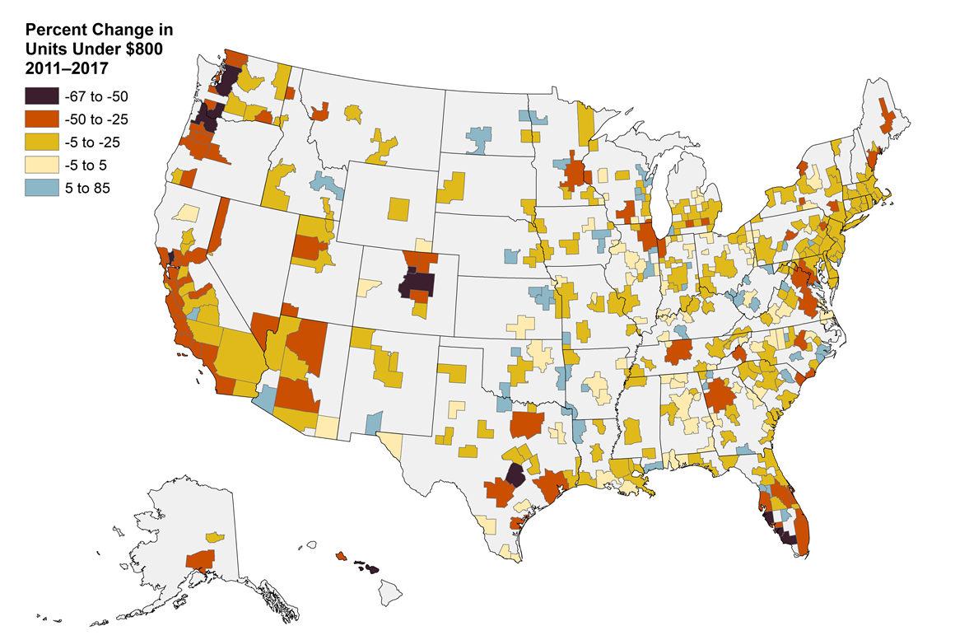
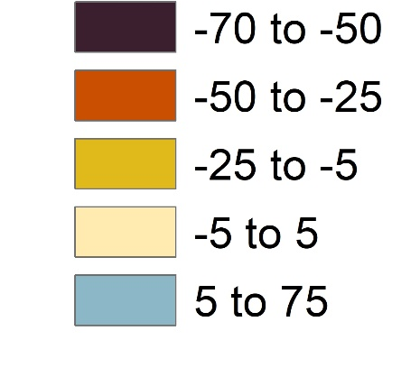
Figure 30. The Low-Rent Stock in Most Metros Has Declined Substantially Since 2011
Change in Units with Rents under $800, 2011–2017
50% or Greater Decline (Up to 67%)
25–49% Decline
5–24% Decline
Unchanged
5% or Greater Increase (Up to 85%)
Notes: Rents are adjusted to 2017 dollars using CPI-U for All Items Less Shelter.
Source: JCHS tabulations of US Census Bureau, American Community Survey 1-Year Estimates and Missouri Census Data Center.

Slide 37
Chapter 6. Housing Challenges

Slide 38
Figure 31. While the Number of Cost-Burdened Homeowner Households Has Receded…
Notes: Cost-burdened (severely cost-burdened) households pay more than 30% (more than 50%) of their income on housing. Households with zero or negative income are assumed to have burdens, while households paying no cash rent are assumed to be without burdens.
Source: JCHS tabulations of US Census Bureau, American Community Survey 1-Year Estimates.

Slide 39
Figure 32. …The Number of Cost-Burdened Renters Remains Close to Peak Levels
Notes: Cost-burdened (severely cost-burdened) households pay more than 30% (more than 50%) of their income on housing. Households with zero or negative income are assumed to have burdens, while households paying no cash rent are assumed to be without burdens.
Source: JCHS tabulations of US Census Bureau, American Community Survey 1-Year Estimates.

Slide 40
Figure 33. In Expensive Rental Markets, Even Higher-Income Households Face Cost Burdens
Notes: Cost-burdened households pay more than 30% of their income on housing. Households with zero or negative income are assumed to have burdens, while households paying no cash rent are assumed to be without burdens. Only the 100 most populous metropolitan areas as of 2017 are shown, categorized by cost. Highest-cost metros are those with the highest median gross rent.
Source: JCHS tabulations of US Census Bureau, 2017 American Community Survey 1-Year Estimates and Missouri Census Data Center.

Slide 41
Figure 34. When Burdened with High Housing Costs, Lowest-Income Families with Children Spend Little on Other Basic Needs
Notes: All numbers are averages for households with children under 18. Low-income families with children are in the bottom quartile of families with children ranked by total spending. Households whose housing accounts for 30% to 49% of their total expenditures are considered moderately cost-burdened. Households whose housing accounts for 50% or more of their total expenditures are considered severely cost-burdened.
Source: JCHS tabulations of Bureau of Labor Statistics, 2017 Consumer Expenditure Survey.

Slide 42
Figure 35. Affordability Restrictions on Nearly 1.2 Million Rental Units Are Set to Expire by 2029
Note: Data include properties with active subsidies as of January 1, 2019. Other includes units funded by HOME Rental Assistance, FHA Insurance, Section 236 Insurance, Section 202 Direct Loans, USDA Section 515 Rural Rental Housing Loans, and units in properties with more than one subsidy type expiring on the same day. For properties with multiple subsidies, if one subsidy expires but one or more others remain active, the difference between the number of units assisted by the expiring subsidy and the number of units assisted by the remaining subsidies are counted as expired. NHPD estimates do not account for state incentives to extend affordability restrictions or for potential early departures from the programs (e.g. through QC processes).
Source: JCHS tabulations of Public and Affordable Housing Research Corporation and National Low Income Housing Coalition, National Housing Preservation Database.

Slide 43
Figure 36. Although Homelessness is Down Overall, the Unsheltered Population Began to Rise in 2015
Note: Homeless persons are considered sheltered if they are staying in emergency shelters, transitional housing, or safe havens.
Source: JCHS tabulations of US Department of Housing and Urban Development, 2018 Annual Homeless Assessment Report, Point-in-Time Estimates of Homelessness.

Slide 44
Figure 37. Highly Damaging Natural Disasters Have Become Much More Frequent and Costly
Billions of Dollars
Note: All values are constant March 2019 dollars adjusted by the CPI-U for All Items.
Source: JCHS tabulations of National Oceanic and Atmospheric Administration, Billion-Dollar Weather and Climate Disasters: Time Series.

