Slide 1
America’s Rental Housing 2022

Slide 2
1. Executive Summary

Slide 3
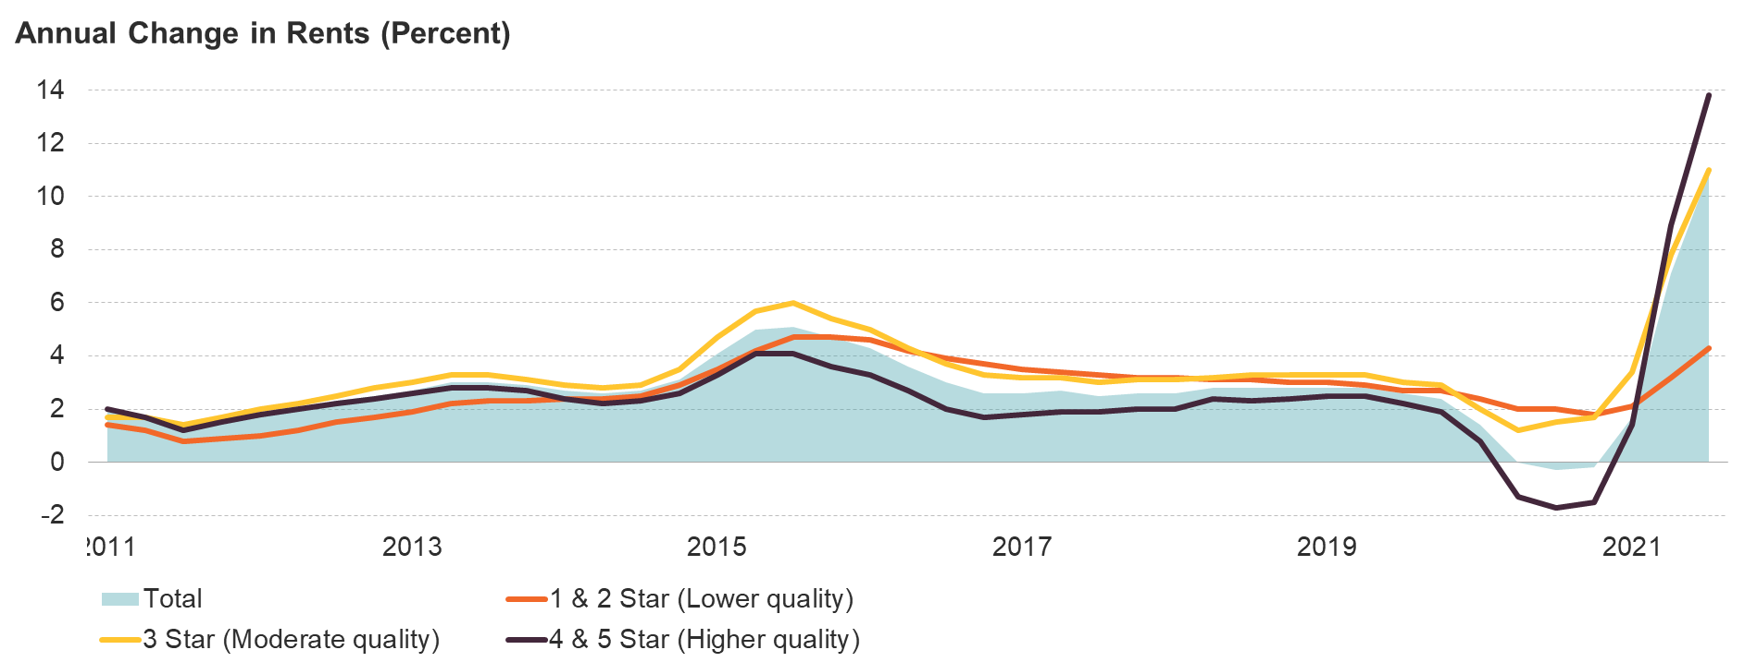
Figure 1: After a Brief Dip, Rents for Higher-Quality Apartments Soared in 2021
2011
2013
2015
2017
2019
2021
Note: Apartment quality is based on the CoStar Building Rating System for professionally managed market-rate apartments in buildings with five or more units.
Source: JCHS tabulations of CoStar data.

Slide 4
Figure 2: Federal Support Throughout the Pandemic Has Helped to Keep Renters in Their Homes
 | 2020 |  |  |  |  |  |  | 2021
 | Mar– Apr |  | May– Jun | Jul– Aug |  | Sept– Oct | Nov– Dec | Jan– Feb | Mar– Apr | May– Jun | Jul– Aug | Sept– Oct
Eviction Moratoriums | CARES Act |  |  |  |  | CDC Orders
Emergency Rental Assistance |  |  |  |  |  |  |  | Consolidated Appropriations Act ($25 billion)
 |  |  |  |  |  |  |  |  | American Rescue Plan Act ($21.55 billion)
Stimulus Checks | $1,200 |  |  |  |  |  | $600 |  | Up to $1,400
Expanded Unemployment |  | $600 per week |  |  |  |  |  | $300 per week
Notes: The Consolidated Appropriations Act, passed in late December 2020, began disbursing funds in January 2021. Distribution of ERA continued into 2022.
Sources: Government Accountability Office, Internal Revenue Service, US Department of Labor, US Department of the Treasury.
Notes:
Formerly ES-3

Slide 5
Figure 3: The Share of Lower-Income Renters with Cost Burdens Remains Stubbornly High
Household Income
Notes: Incomes are adjusted for inflation using the CPI-U for All Items. Cost-burdened households pay more than 30% of income for housing. Source: JCHS tabulations of US Census Bureau, American Community Survey 1-Year Estimates.
Notes:
Formerly ES-5

Slide 6
Figure 4: Higher-Income Households Have Driven Most of the Recent Growth in Renters
Note: Incomes are adjusted for inflation using the CPI-U for All Items.
Source: JCHS tabulations of US Census Bureau, American Community Survey 1-Year Estimates via IPUMS USA, University of Minnesota.

Slide 7
Figure 5: The Heated Pace of Multifamily Construction Is Adding Hundreds of Thousands of Units to the Rental Stock
Note: Data for 2021 represent the seasonally adjusted average from January–November 2021.
Source: JCHS tabulations of US Census Bureau, New Residential Construction data.
Notes:
Formerly ES-6

Slide 8
Figure 6: Housing Assistance Provides Crucial Support for the Nation’s Most Vulnerable Households
Notes: Households with a disability are headed by a person who has a disability or has a spouse with a disability. Household shares include those assisted by housing choice vouchers, public housing, project-based Section 8, Section 202, and Section 811.
Source: JCHS tabulations of HUD, 2020 Public Use Microdata Sample.
Notes:
Formerly C-4

Slide 9
2. Renter Households

Slide 10
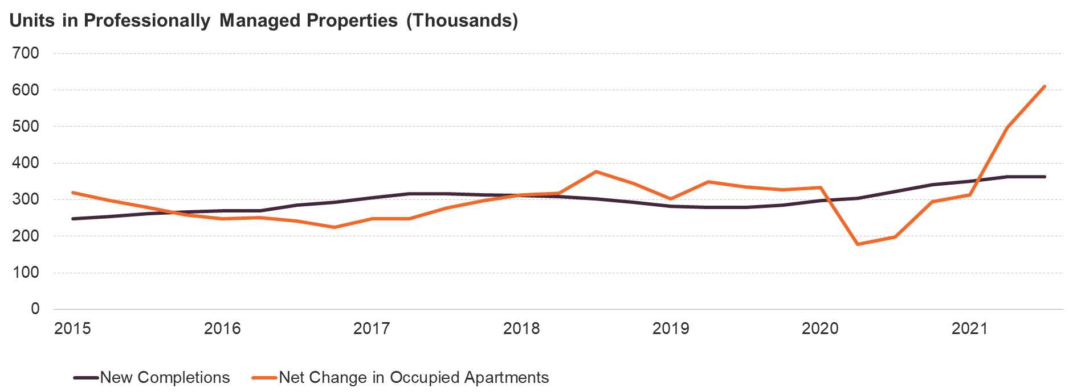
Figure 7: Rental Demand Far Outpaced Growth in New Supply in 2021
2015
2017
2019
2021
Note: Data are four-quarter rolling totals for professionally managed apartments in buildings with five or more units.
Source: JCHS tabulations of RealPage data.

Slide 11
Figure 8: Robust Growth in the Younger Population Has Helped to Boost Rental Demand
Source: JCHS tabulations of US Census Bureau, 2019 Population Estimates and 2019 American Community Survey 1-Year Estimates.

Slide 12
Figure 9: Renters Are Much More Likely than Homeowners to Be Single, to Be Households of Color, and to Have Lower incomes
Household Type
Household Income
Notes: Black, Asian, white, and another race(s) householders are non-Hispanic. Hispanic householders may be of any race(s). The ‘All Other’ household type includes both unrelated/roommates and other types of families.
Source: JCHS tabulations of US Census Bureau, 2019 American Community Survey 1-Year Estimates.

Slide 13
Figure 10: Disproportionately Large Shares of Black Renter Households Are in the Lowest Income Groups
Household Income
Notes: Black, white, and Asian householders are non-Hispanic. Hispanic householders may be of any race(s). Multiracial or householders of another race are not shown.
Source: JCHS tabulations of US Census Bureau, 2019 American Community Survey 1-Year Estimates.

Slide 14
Figure 11: Renter Mobility Rates Have Fallen to Record Lows Since the Pandemic Began
Type of Move
Note: Excludes group quarters and all imputed mobility values.
Source: JCHS tabulations of US Census Bureau, Current Population Surveys via IPUMS-CPS, University of Minnesota.

Slide 15
3. Rental Stock

Slide 16
Figure 12: Larger Multifamily Buildings Account for Most of the Recent Growth in the Rental Stock
Note: Rental units may be occupied, vacant for rent, or rented but unoccupied.
Source: JCHS tabulations of US Census Bureau, American Community Survey 1-Year Estimates.

Slide 17
Figure 13: The Types of Housing Available for Rent Range Widely Across Markets With Low-Rent Units Much More Prevalent in Rural Areas
Notes: Data include occupied rental units only. Manufactured housing includes other structures such as boats and RVs. Contract rents exclude utility costs.
Sources: JCHS tabulations of US Census Bureau, 2019 American Community Survey 5-Year Estimates; Housing Assistance Council's Rural & Small Town Typology Database.

Slide 18
Figure 14: Rental Property Owners Continue to Invest Heavily in Capital Improvements
Notes: Market spending is in nominal dollars. Improvements include remodels, replacements, additions, structural alterations, and other activities that increase the value of the housing stock. Maintenance projects preserve the current quality of homes.
Source: JCHS analysis of US Census Bureau, Surveys of Residential Alterations and Repairs (C-50), and National Apartment Association, Surveys of Operating Income & Expenses.

Slide 19
Figure 15: Inadequacy is More Common in Older Rental Housing
Notes: Rental units may be occupied, vacant for rent, or rented but unoccupied. Housing inadequacy includes large holes and leaks or the absence of basic features such as plumbing, electricity, water, or heat. Units are moderately or severely inadequate depending on the type and number of these physical problems.
Source: JCHS tabulations of HUD, 2019 American Housing Survey.

Slide 20
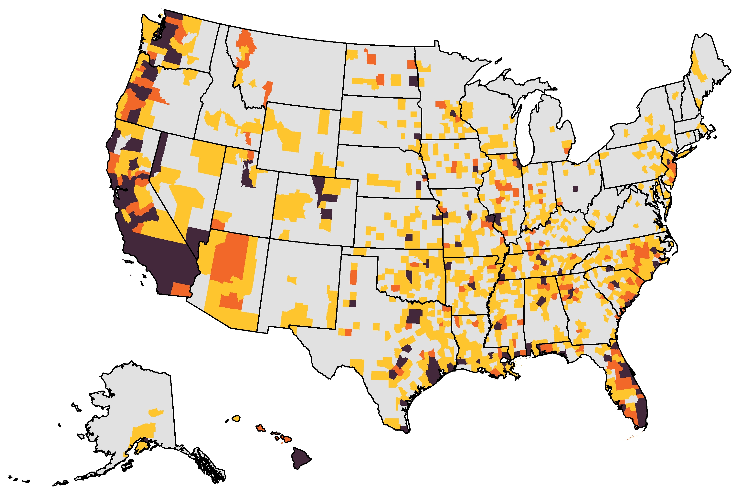
Figure 16: More Than 17 Million Rental Units Are Under Threat from Natural Disasters
Number of Units
In High-Risk Counties
Under 2,000
2,000–9,999
10,000–19,999
20,000 and Over (Up to 1.6 Million)
Notes: High-risk areas have a Relatively Moderate, Relatively High, or Very High Expected Annual Loss (EAL) score. EAL represents the average economic loss in dollars resulting from natural hazards each year. The number of units in high-risk counties are aggregated from the tract level.
Source: JCHS tabulations of Federal Emergency Management Agency, November 2021 National Risk Index EAL data, and US Census Bureau, 2019 American Community Survey 5-Year Estimates.

Slide 21
4. Rental Housing Markets

Slide 22
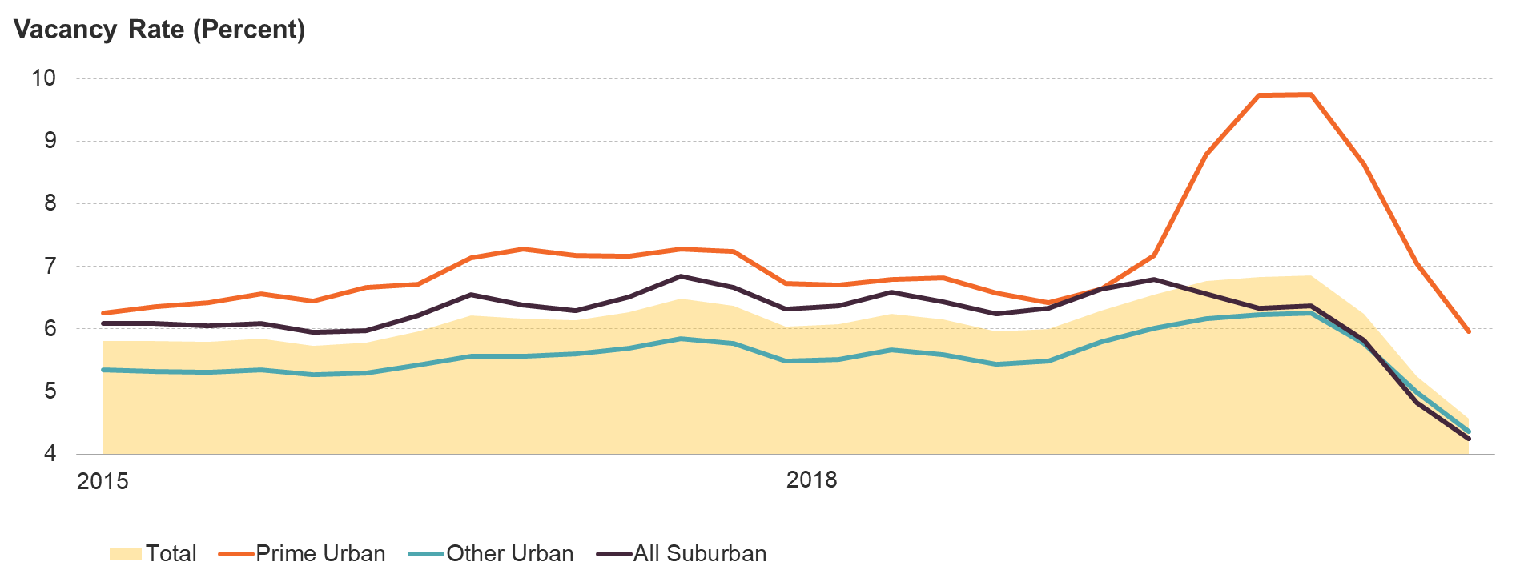
Figure 17: After a Sharp Rise, Vacancy Rates in Prime Urban Markets Plunged to Historic Lows
2015
2016
2017
2019
2020
2021
Notes: Urban/suburban areas are defined based on density in the 54 largest markets that CoStar tracks. Prime submarkets are those with the highest rents.
Source: JCHS tabulations of CoStar data.

Slide 23
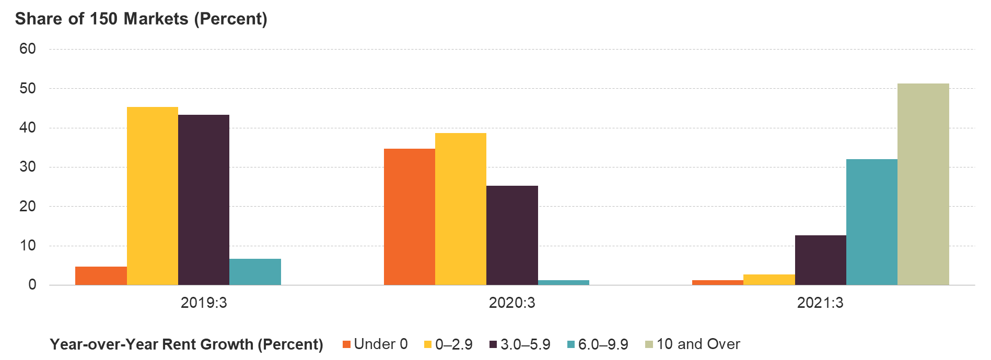
Figure 18: Rents in Over Half of the Nation’s Largest Markets Were Up by Double Digits in 2021
Note: Rent growth rates are for professionally managed apartments in buildings with at least 5 units in the 150 markets RealPage tracks.
Source: JCHS tabulations of RealPage data.

Slide 24
Figure 19: Soaring Home Prices Have Added to the Pressure on Rents
2015
2016
2017
2018
2019
2020
2021
Source: JCHS tabulations of Zillow data.

Slide 25
Figure 20: Both Single-Family and Multifamily Rental Construction Remained Elevated in 2021
Note: Housing starts are the four-quarter trailing sum.
Source: JCHS tabulations of US Census Bureau, New Residential Construction data.

Slide 26
Figure 21: Non-Individual Investors Own a Growing Share of Rental Properties
Note: Non-individual investors include partnerships, trustees for estate, real estate corporations, Real Estate Investment Trusts, nonprofit organizations, and other entities.
Source: JCHS tabulations of US Census Bureau, Rental Housing Finance Surveys.

Slide 27
5. Rental Affordability

Slide 28
Figure 22: Lower-Income Households and Households of Color Were More Likely To Have Fallen Behind on Rent
Share of Households in Arrears (Percent)
Household Income
Notes: Households behind on rent reported that they were not caught up at the time of survey. Black, white, and Asian households are non-Hispanic. Hispanic households may be of any race(s). Multiracial or another race households are not shown.
Source: JCHS tabulations of US Census Bureau, Household Pulse Surveys, July–September 2021.

Slide 29
Figure 23: Both the Number and Share of Cost-Burdened Renter Households Remain Well Above the 2001 Low
Share with Cost Burdens (Percent)
Notes: Moderately (severely) cost-burdened households pay more than 30% (more than 50%) of income for housing. Households with zero or negative income are assumed to have burdens, while households paying no cash rent are assumed to be without burdens.
Source: JCHS tabulations of US Census Bureau, American Community Survey 1-Year Estimates.

Slide 30
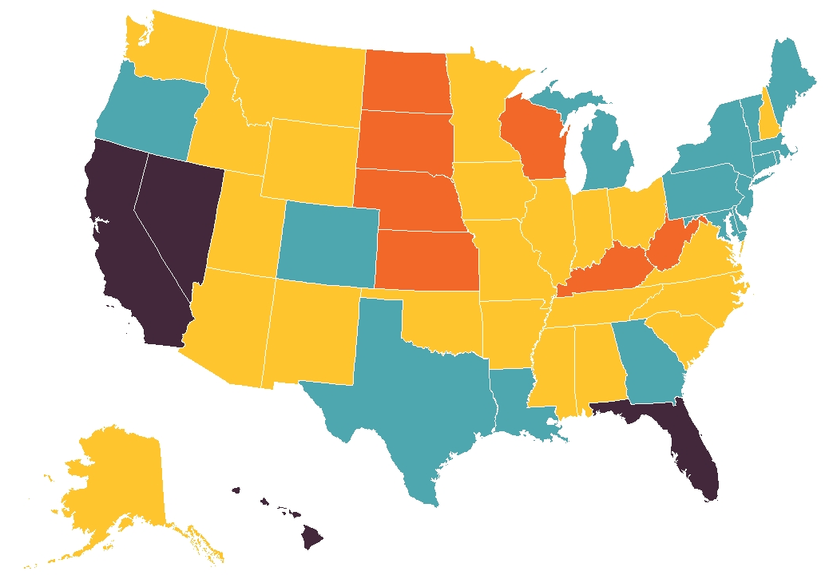
Figure 24: Even in the Most Affordable States, More than a Third of Renters Face Cost Burdens
Share of Cost-Burdened Renters (Percent)
Under 40 (Down to 38)
40–44
45–49
50 and Over (Up to 54)
Notes: Cost-burdened households pay more than 30% of income for housing. Households with zero or negative income are assumed to be burdened, while households paying no cash rent are assumed to be without burdens.
Source: JCHS tabulations of US Census Bureau, 2019 American Community Survey 1-Year Estimates.

Slide 31
Figure 25: High Housing Costs Leave Vulnerable Households Unable to Meet Basic Health Needs
Notes: Chart shows renter households in the bottom quartile of expenditures, which are considered lowest-income households. Households are considered moderately (severely) burdened if housing accounts for more than 30% (50%) of their expenditures. Health expenditures include out-of-pocket costs and premiums.
Source: JCHS tabulations of Bureau of Labor Statistics, 2020 Consumer Expenditure Survey.

Slide 32
Figure 26: The Stock of Low-Rent Units Continues to Shrink
Share of Rental Stock (Percent)
Notes: Low-rent units have contract rents under $600. Rents are inflated to 2019 dollars using the CPI-U Less Shelter. No-cash units are excluded.
Source: JCHS tabulations of US Census Bureau, American Community Survey 1-Year Estimates.

Slide 33
6. Housing Challenges

Slide 34
Figure 27: Government Interventions During the Pandemic Helped to Reduce Evictions
Note: Data include eviction filings in 6 states and 31 cities.
Source: JCHS tabulations of Eviction Lab, Eviction Tracking System through November 31, 2021.

Slide 35
Figure 28: Emergency Rental Assistance Was Initially Slow to Reach Renters in Need
Notes: Data include households served by Emergency Rental Assistance. Some households may have received multiple payments and may be double-counted. Reported households served by ERA2 from April-June are included in the June count.
Source: JCHS tabulations of US Department of the Treasury data.

Slide 36
Figure 29: Individuals Living Outside of Shelters Account for Most of the Recent Increase in the Unhoused Population
Individuals
Notes: People experiencing homelessness in families with children have at least one adult age 18 or over and at least one child under 18. Point-in-time estimates are conducted in January, so the 2020 estimates are pre-pandemic estimates.
Source: JCHS tabulations of HUD, Annual Homeless Assessment Report Point-in-Time Estimates.

Slide 37
Figure 30: More than 13 Million Income-Eligible Households Do Not Receive Rental Assistance
Notes: Extremely low-income households make up to 30% of area median income. Very low-income households make 30–50% of area median income. Assisted households receive a rental subsidy.
Source: JCHS tabulations of US Housing and Urban Development (HUD), 2021 Worst Case Housing Needs Report to Congress.
Notes:
Formerly ES-6

Slide 38
Figure 31: Most Low-Income Renters Had to Cut Back on Essential Expenses to Pay Energy Bills in 2021
Frequency of Spending Cutbacks:
Note: The survey question asks how many months in the past year a household reduced or forewent expenses for basic household necessities such as food or medicine to pay an energy bill.
Source: JCHS tabulations of US Census Bureau, Household Pulse Surveys, July–September 2021.

